Slide 1
Notes:
CQ to start

Slide 4
The main challenges of teaching vocabulary
Trying to motivate 28+ learners of varying abilities to continually learn and revise vocabulary.
Keeping learners engaged and on task.
Teaching the ‘tik-tok’ generation.
Encouraging students to work independently and self reflect .

Slide 5
Strategies to Help Students Learn Vocabulary
activating prior knowledge
receptive and productive vocabulary learning
digital tools
sentence builders
recycling and revisiting vocabulary

Slide 6
1. Activating prior knowledge
Activating prior knowledge is a technique where students are encouraged to revisit what they already know about a topic before they are taught new information.
Brainstorming
Mind maps
KWL Charts
Anticipation Guides

Slide 7
Benefits of using activities to activate prior knowledge
It helps learners use their own personal, educational and cultural knowledge to connect new material to familiar concepts.
Learners can use what they already know as the foundation for new ideas and learning.
By revisiting prior knowledge, learners improve their recalled learning.
Students start to see connections between past, current and future learning.

Slide 8
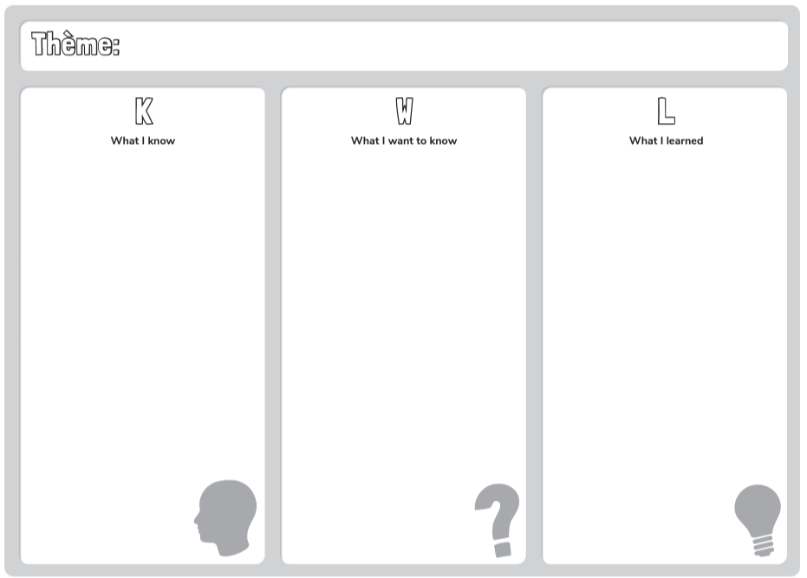

Slide 9
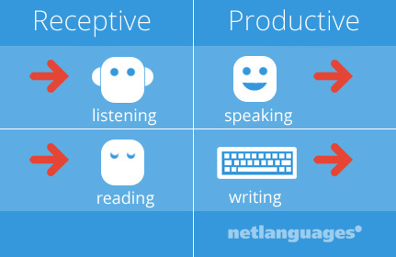
2. Receptive and productive vocabulary learning
Differentiation: categorising vocabulary to help students cope with learning overload
Receptive vocabulary words that you understand when you read or hear them.
Productive vocabulary words that you use when writing or talking.

Slide 10
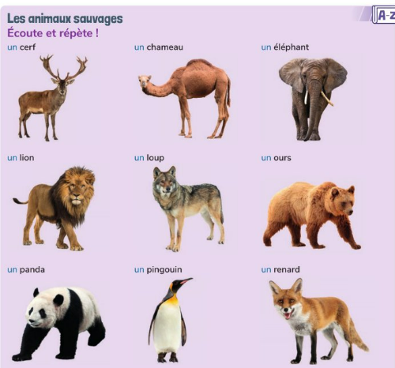
Making it manageable!

Slide 11
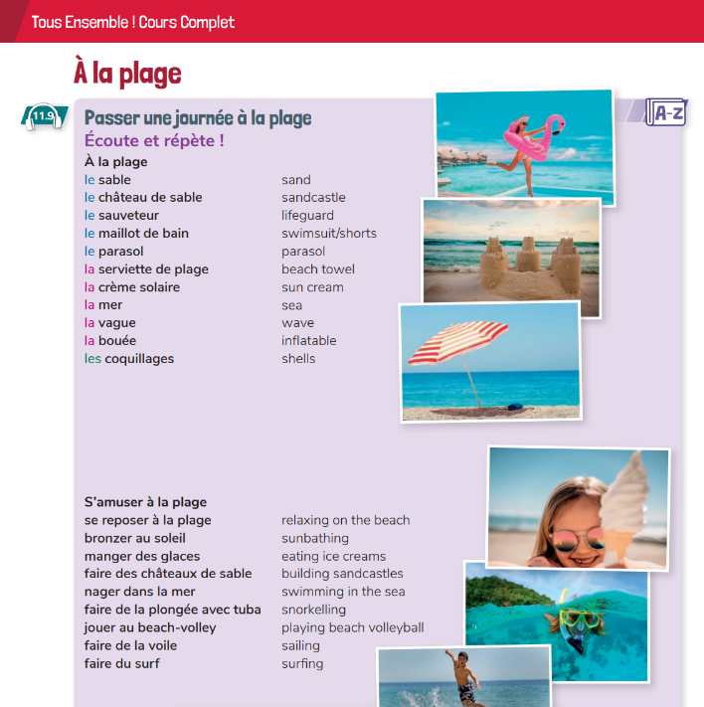
Get the students involved!
Colour coding
Ticking
Highlighting
Grouping words

Slide 12
3. Digital tools
Digital tools help make vocabulary learning fun and tap into our learners love of apps!
Quizlet
Wordwall
Study Stack
Blooket
Kahoot

Slide 13
Digital tools
FOMO
Whichever one you use, use it consistently!

Slide 14
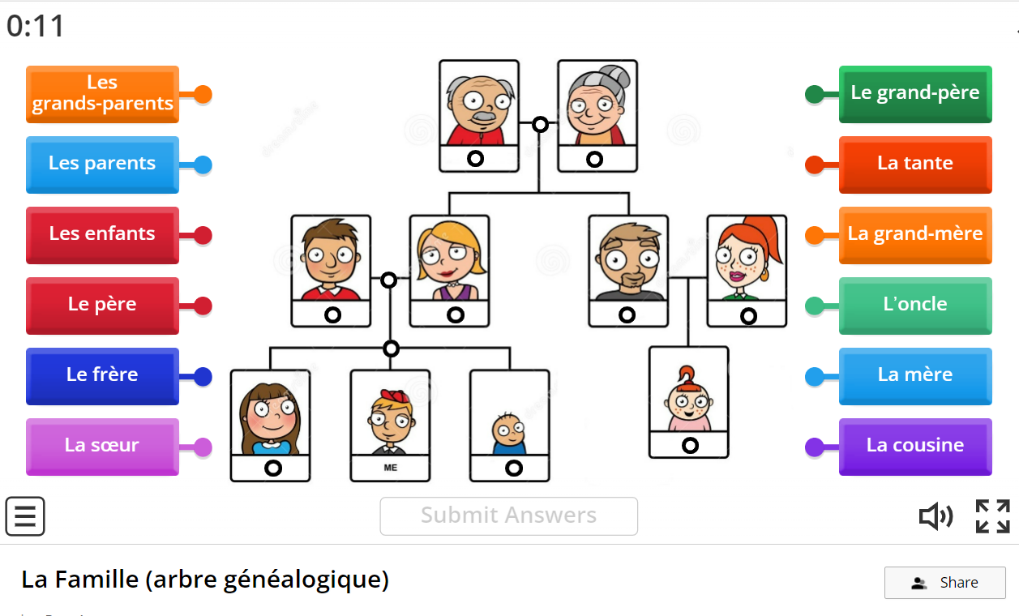
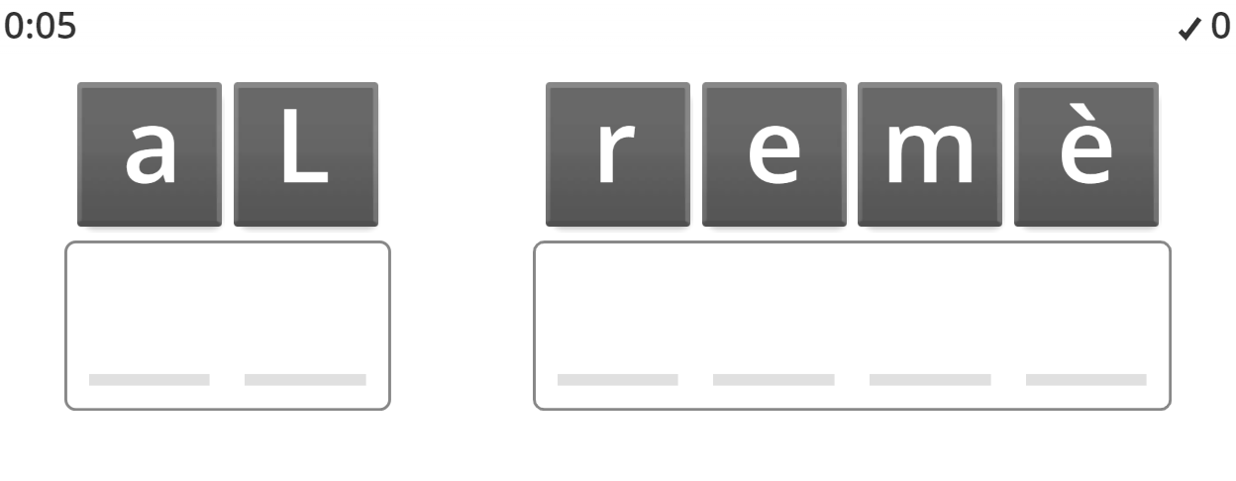
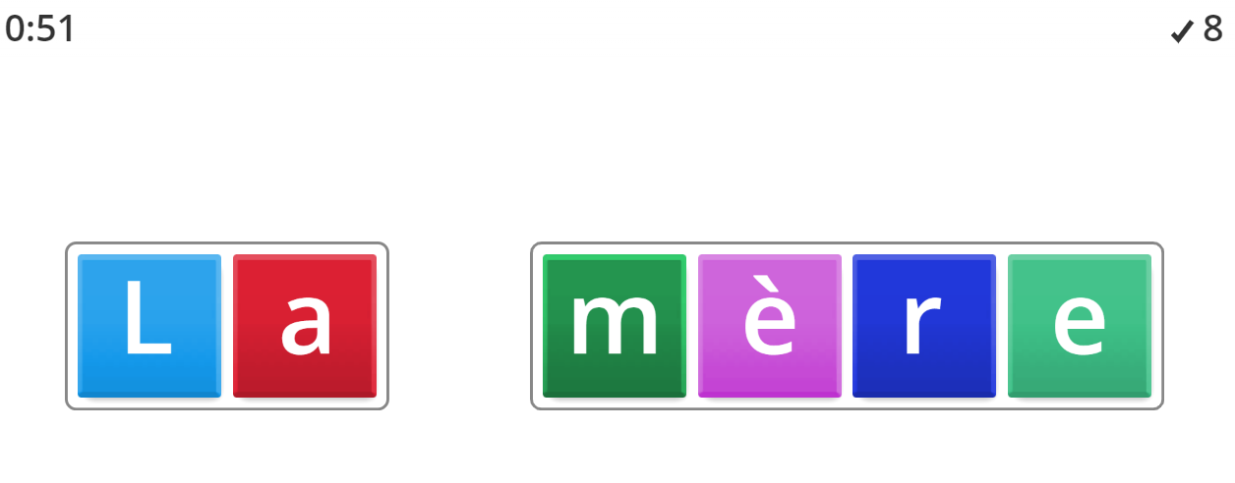

Slide 15
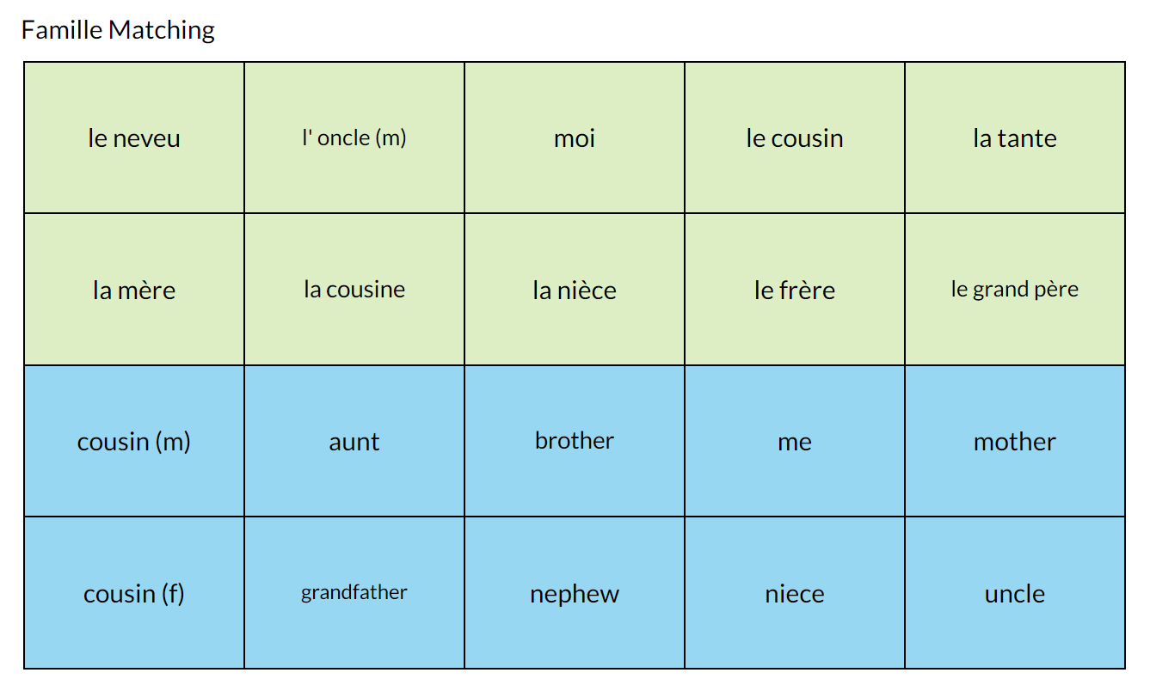
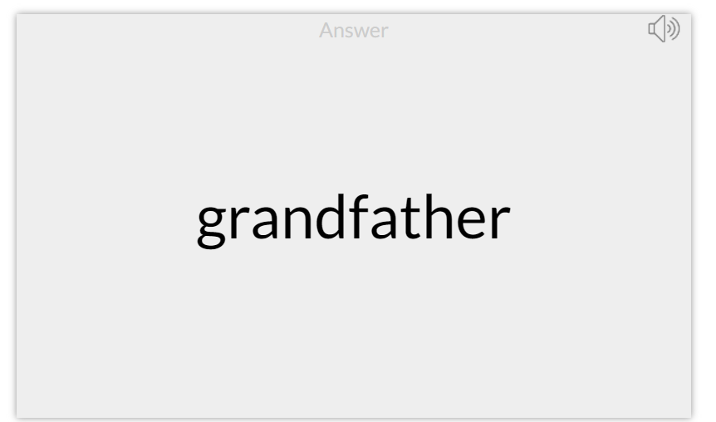

Slide 16
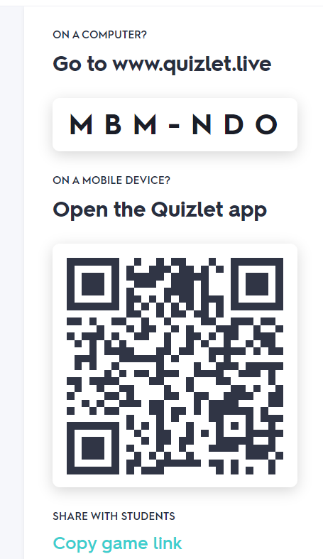
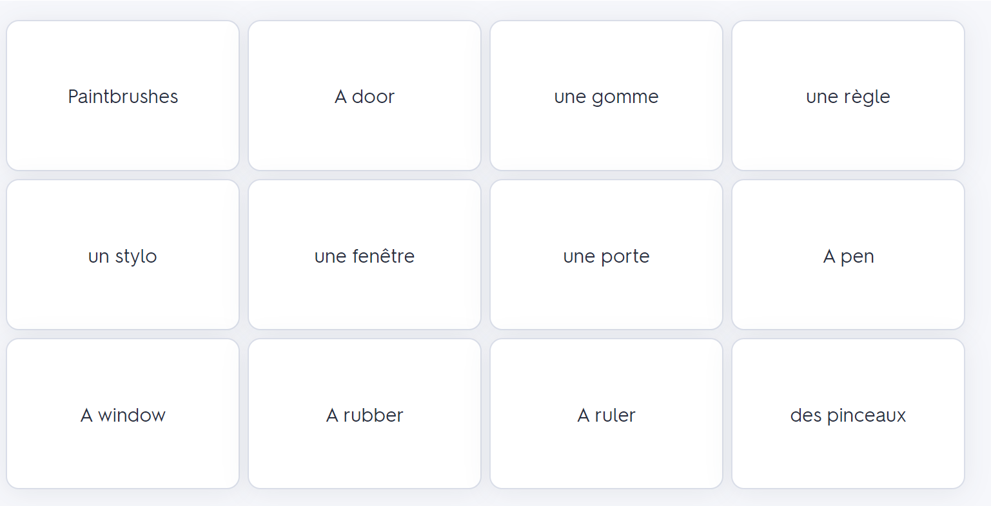
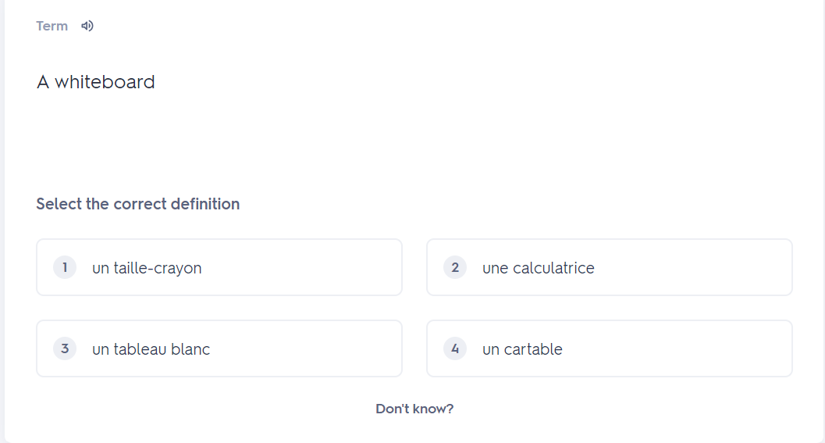
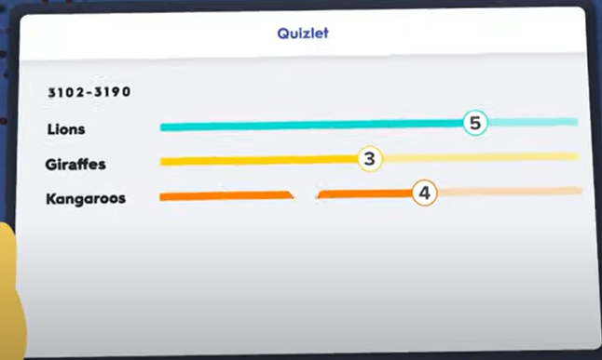

Slide 18
Monologues
Spoken production
Portfolio tasks
CBA prep

Slide 19
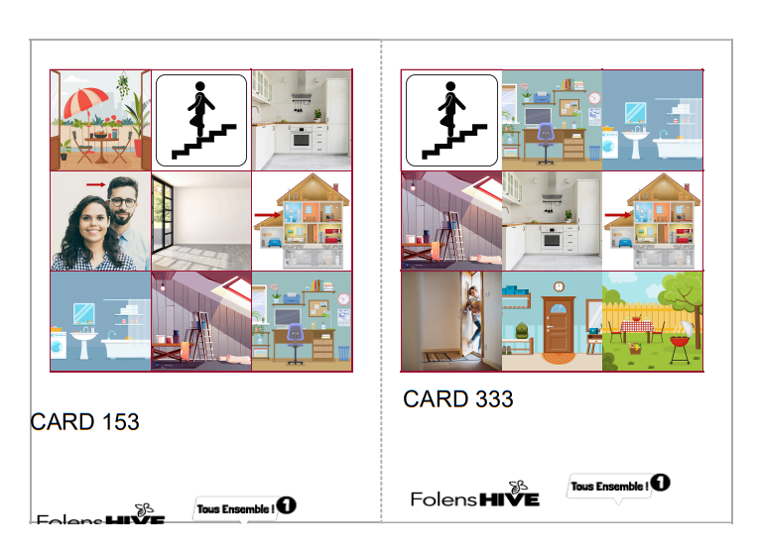
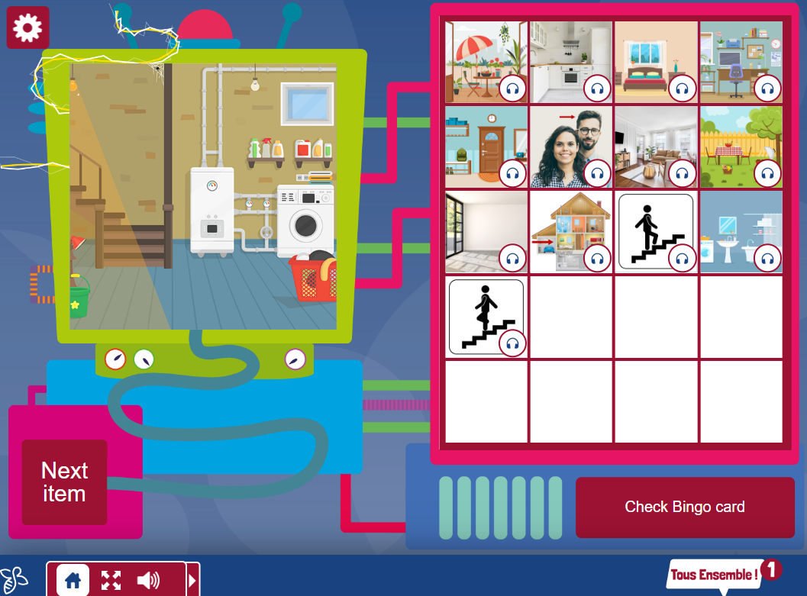

Slide 20
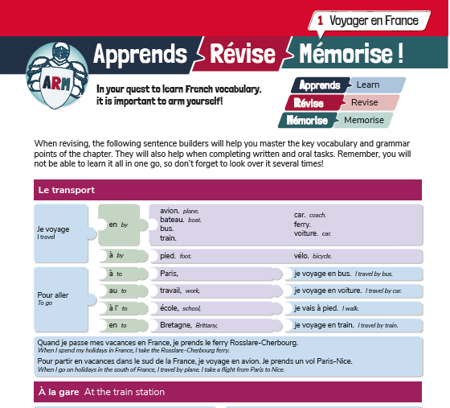
4. Sentence builders
Detailed sentence builders, allow learners to work independently.
They are especially useful in providing all learners with the tools to successfully complete written and oral tasks (the most difficult productive tasks).

Slide 21
A flexible resource
Sentence builders are a low prep but highly adaptable resource which allow learners to practice the 5 key skills.
They are a great way to build differentiation into lessons in the language classroom.

Slide 22
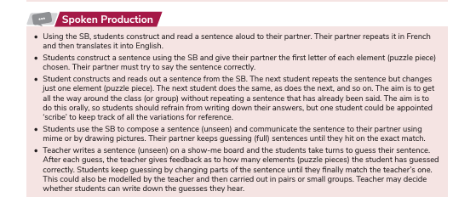
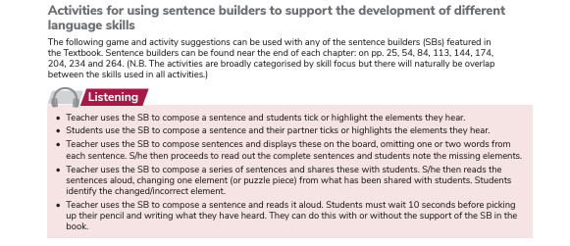
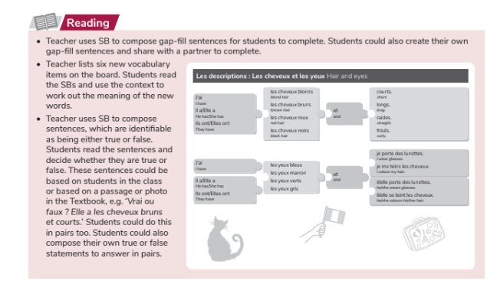

Slide 23
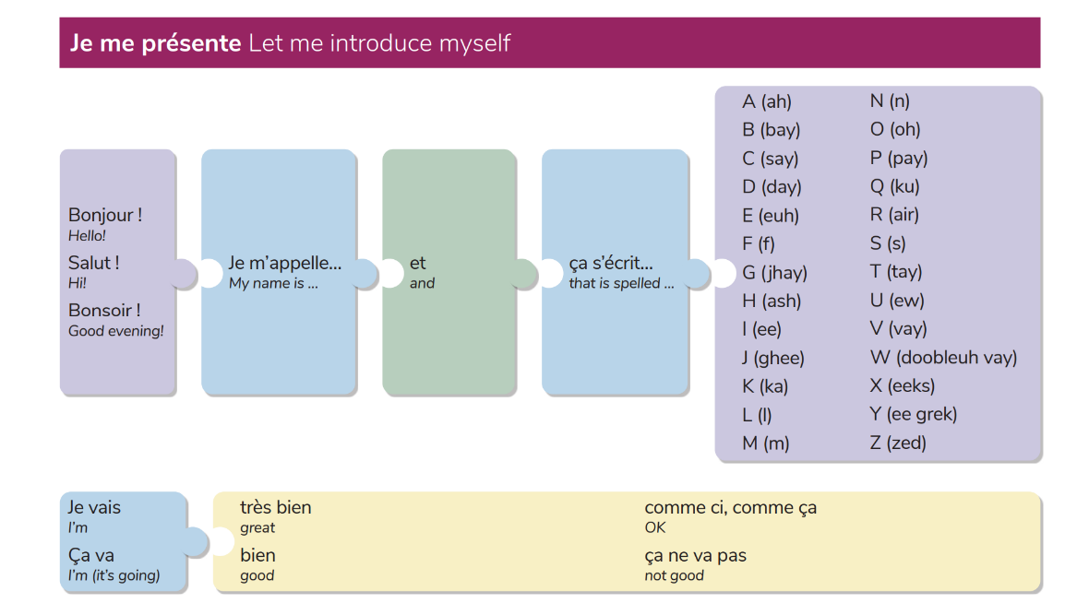
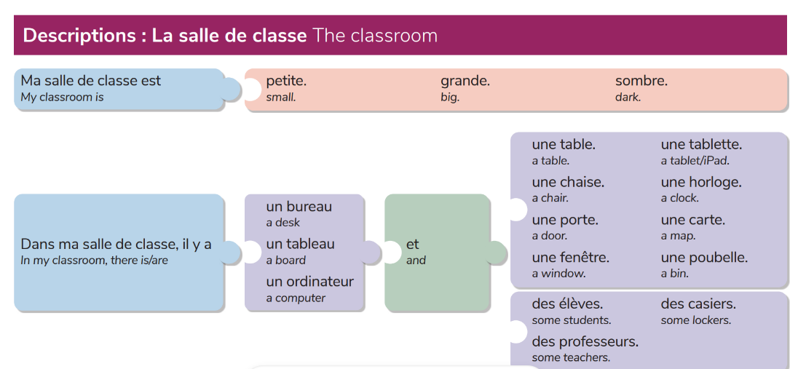
Classwork
Pair/Group work
Homework
Revision
Alternative assessment – open book tests

Slide 24
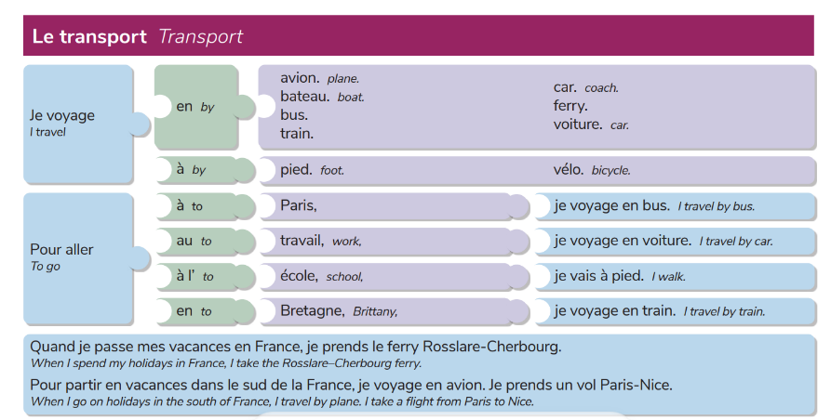
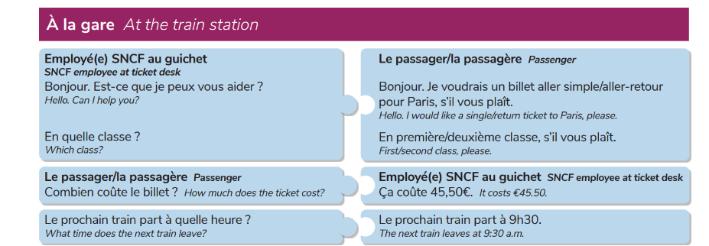
Portfolio pieces
Tâches clés

Slide 25
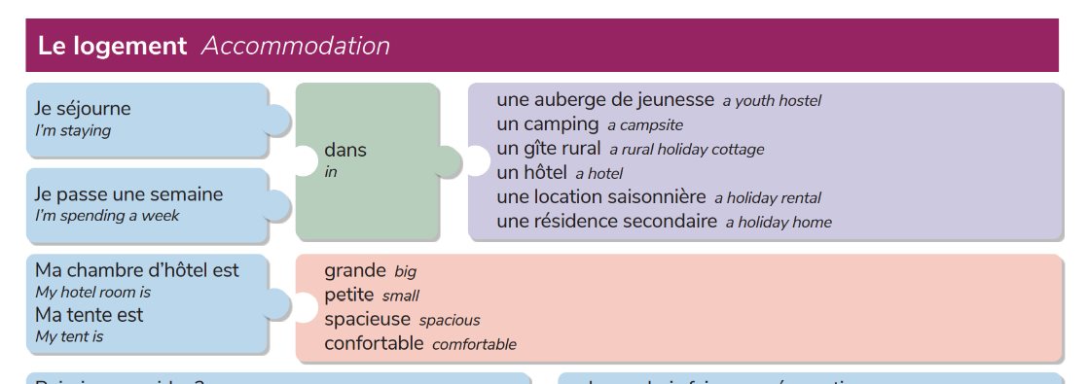
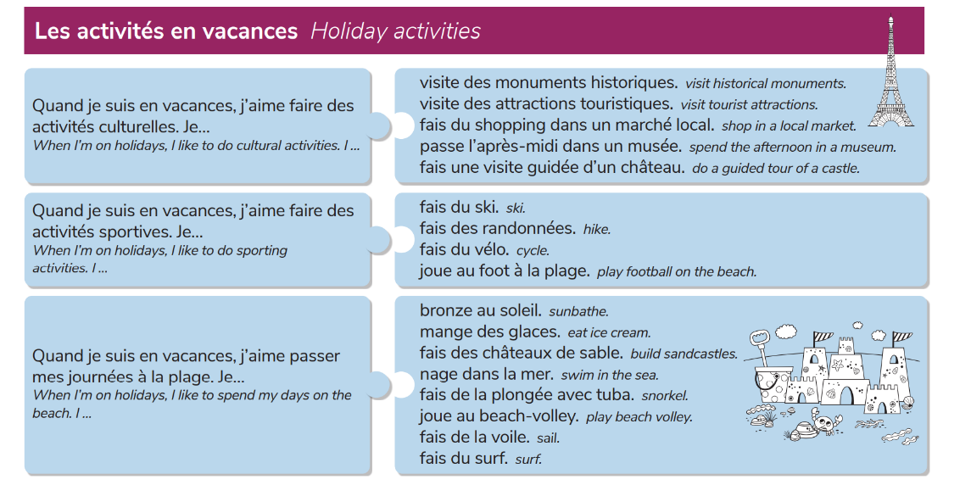
CBA Prep
Blog
Email

Slide 26
5. Recycling and revisiting vocabulary
In order to really internalise vocabulary, we must present our leaners with opportunities to recycle and revisit previous learned words on a regular basis.

Slide 27
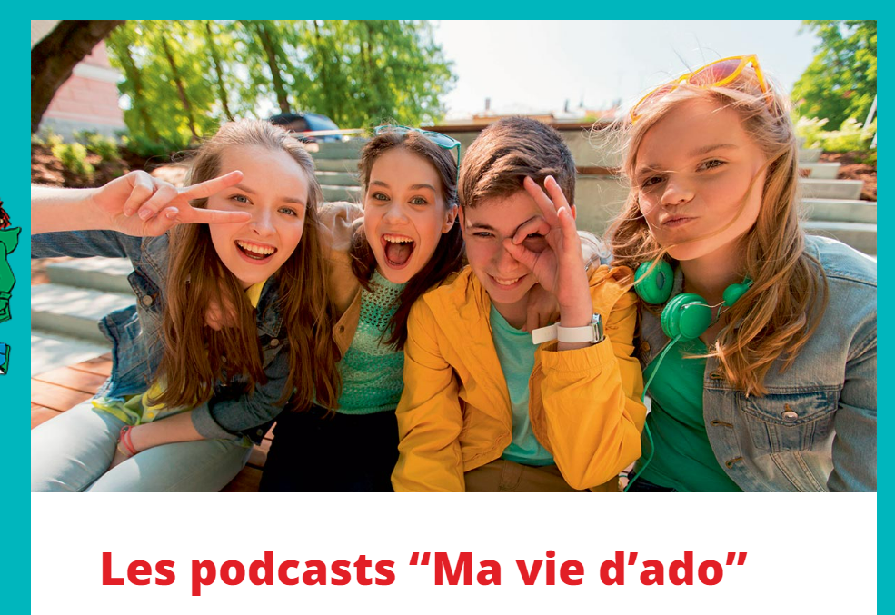
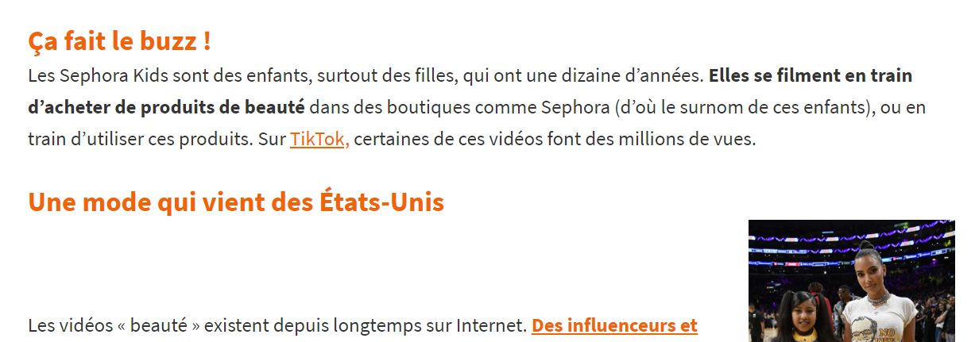
Recycling: Provide learners with opportunities to use/see the vocabulary in different contexts and settings.
Accessible News Websites

Slide 28
Revisiting: Helps learner’s brains to form long-term memories of vocabulary and structures.
Creating flash cards
Duolingo
AFL – Mini-quiz

