Slide 1
Learning Module 1:
All About Me!

Slide 2
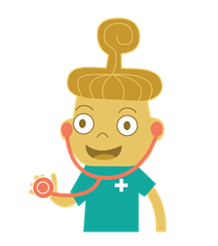
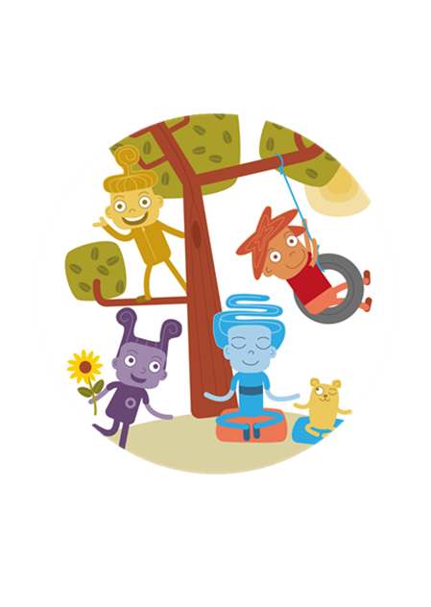
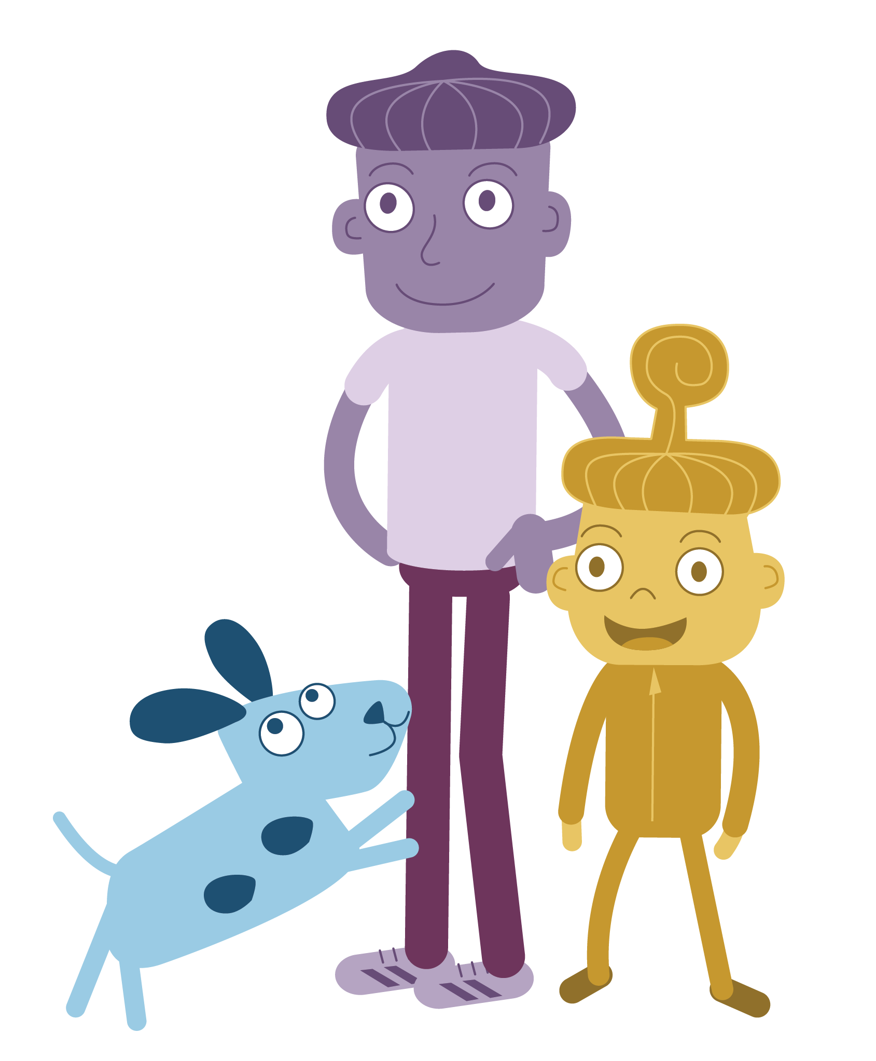
Appa’s family
Appa’s friends

Slide 3
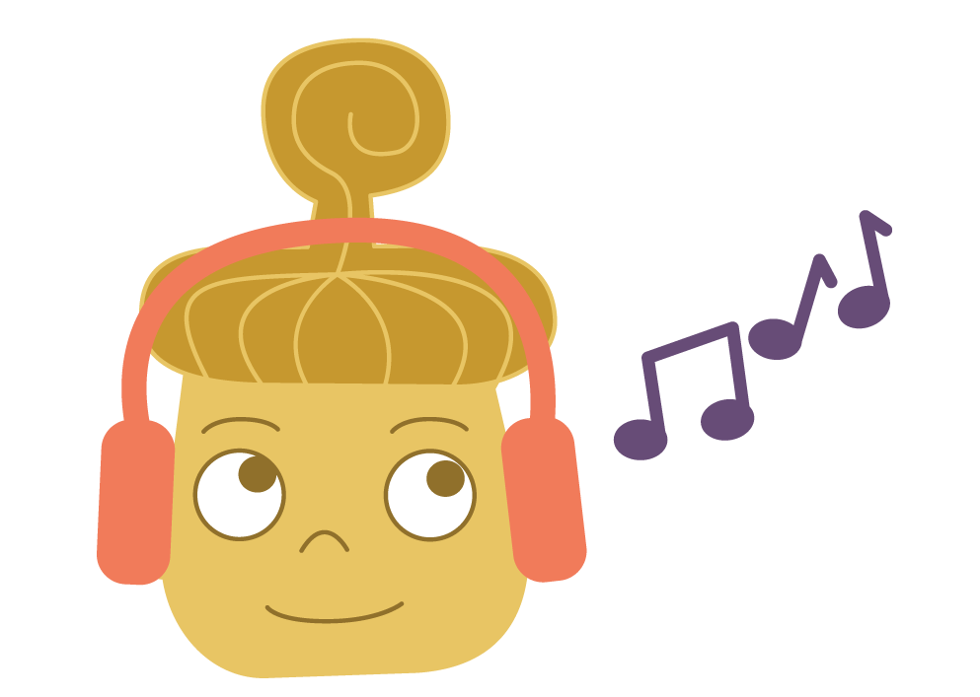
1. Listening to music
2. Watching movies with family
3. Jumping on the trampoline
Spelling tests
2. Fighting with friends
3. Thunderstorms

Slide 4
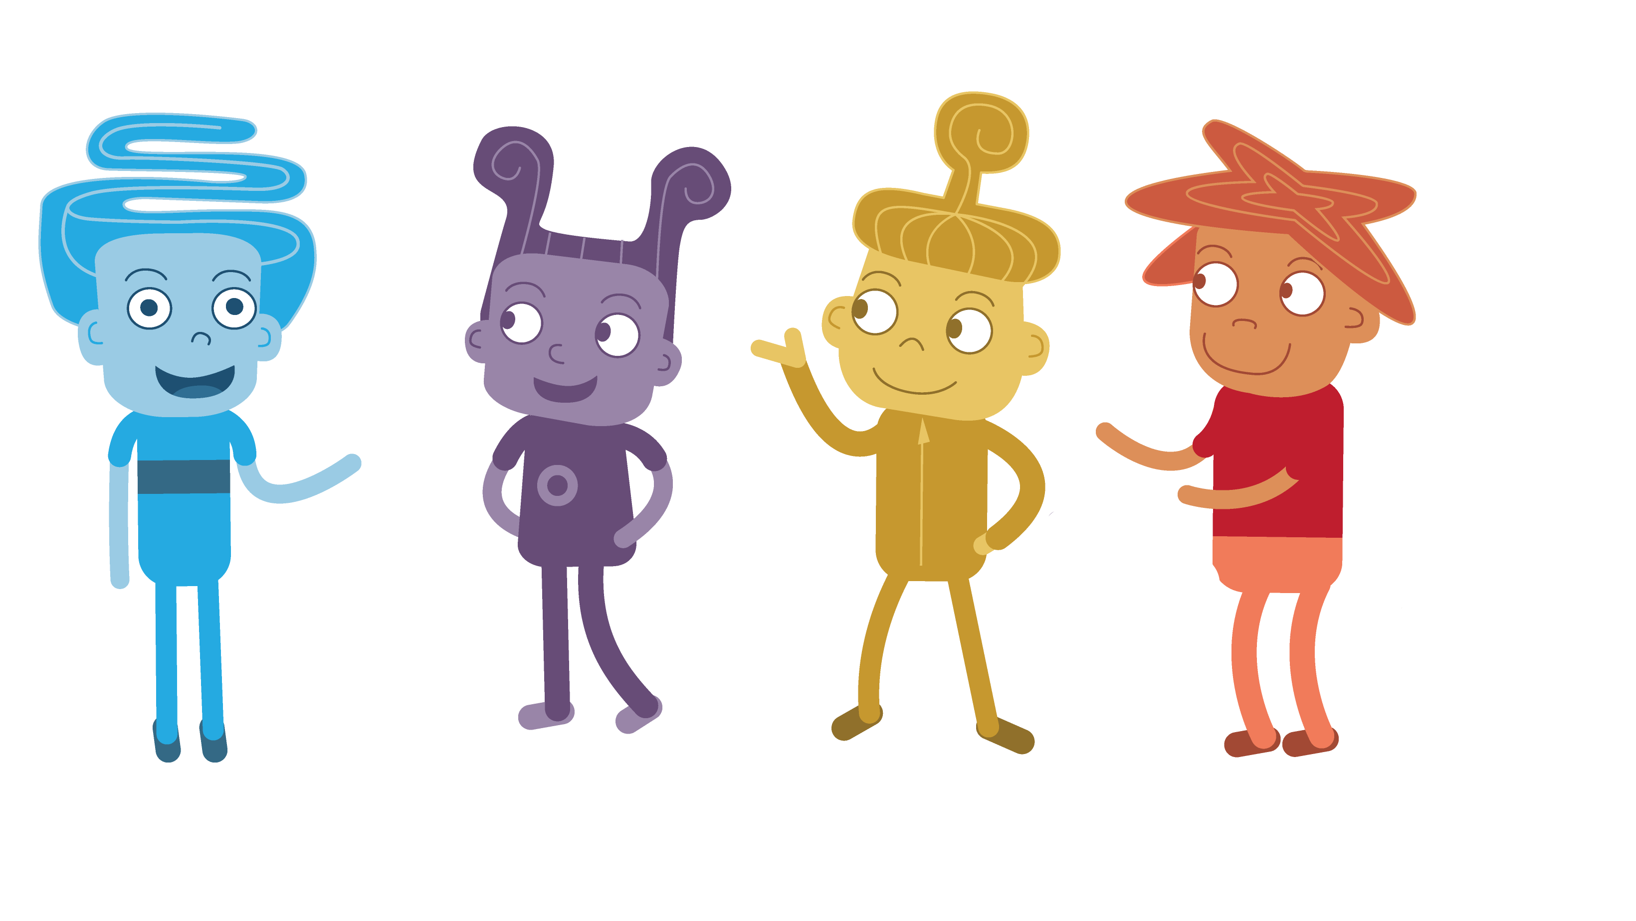
Obi
Pip
Lan

Slide 5
What makes
YOU unique?

