Slide 1
Strand 1
River landscapes
Topic 11
Learning outcome 1.5: explain how the processes of erosion, deposition and transportation shape our fluvial, marine, and glacial landscapes

Slide 2
River landscapes
What will I learn?
The parts of a river
River processes
How river processes shape the landscape
Key skills
Staying well, appreciating the power of rivers and knowing to exercise care when near rivers

Slide 3
River landscapes
Why am I learning this?
From rushing waterfalls, through winding meanders to broad, flat estuaries, rivers are powerful agents that shape the landscape. Find out all about rivers in this topic.
Success criteria
I can describe a river landscape.
I understand how different processes affect rivers.
I am able to identify river landforms and the processes that formed them.

Slide 4
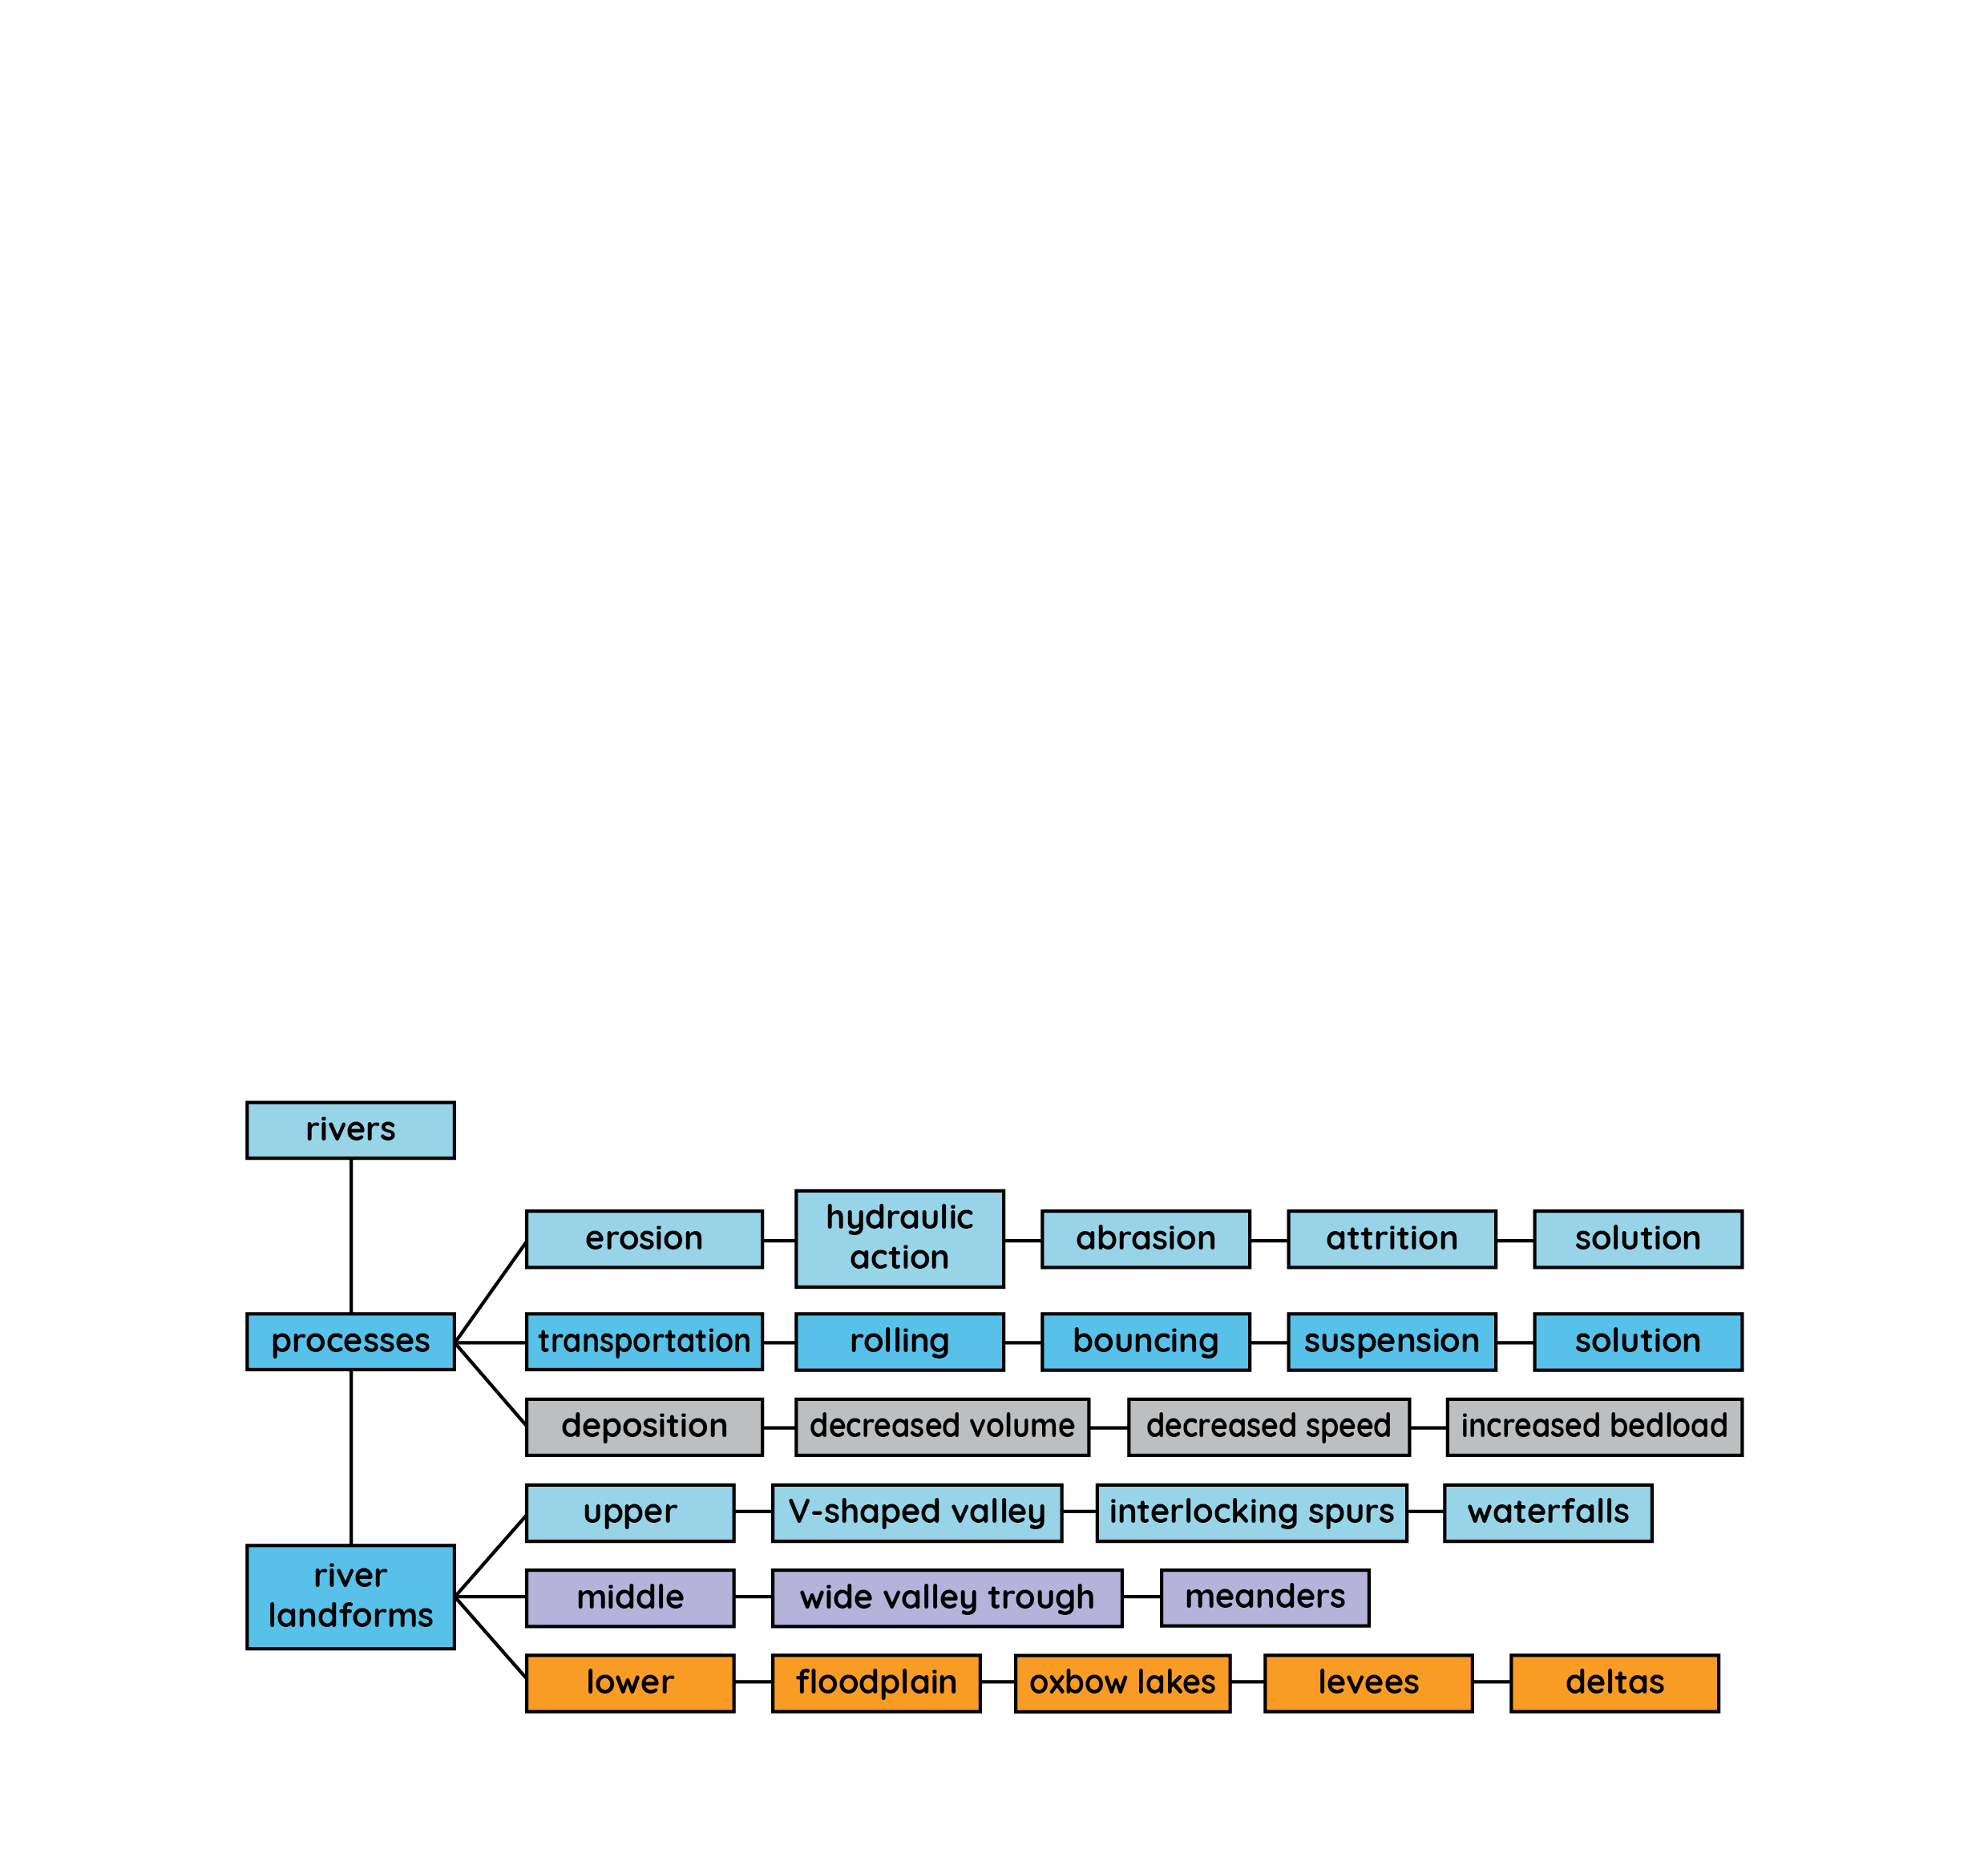
River landscapes
Keyword connections

Slide 5
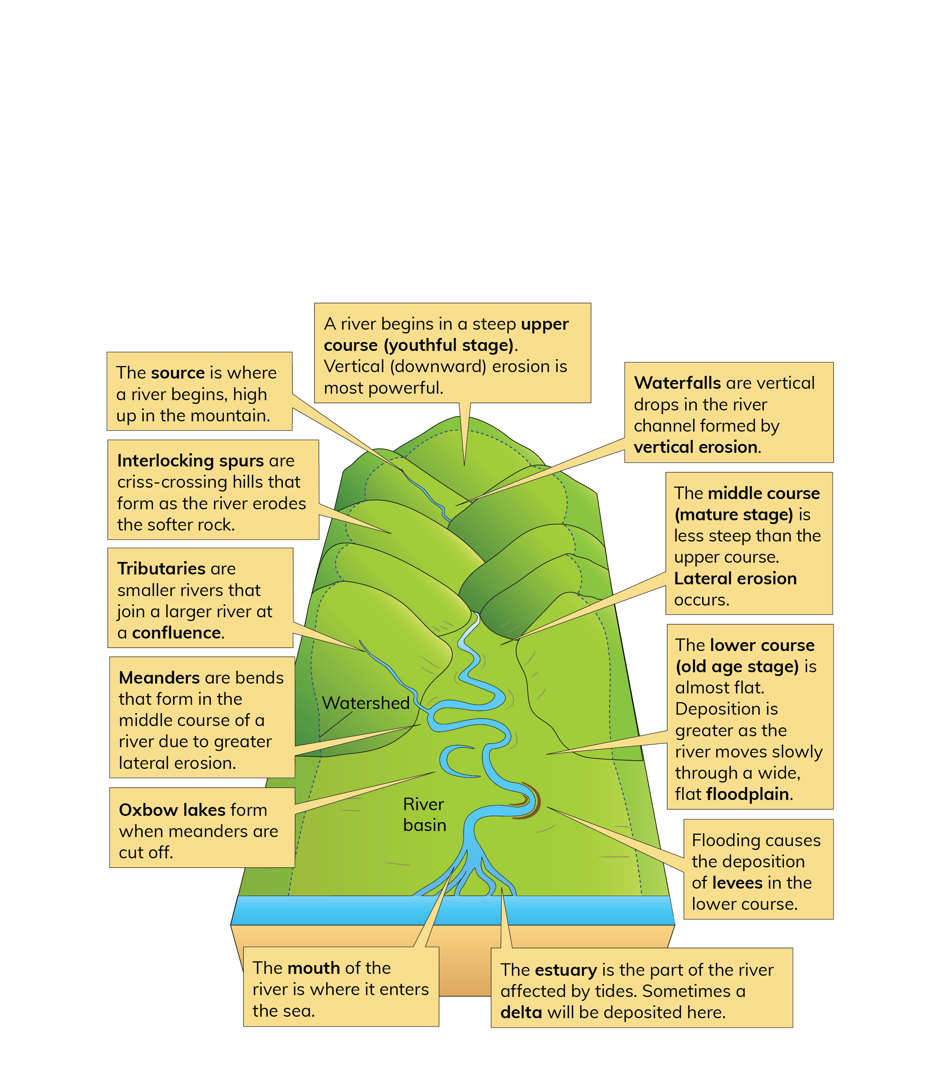
River landscapes
Landscape features of rivers

Slide 6
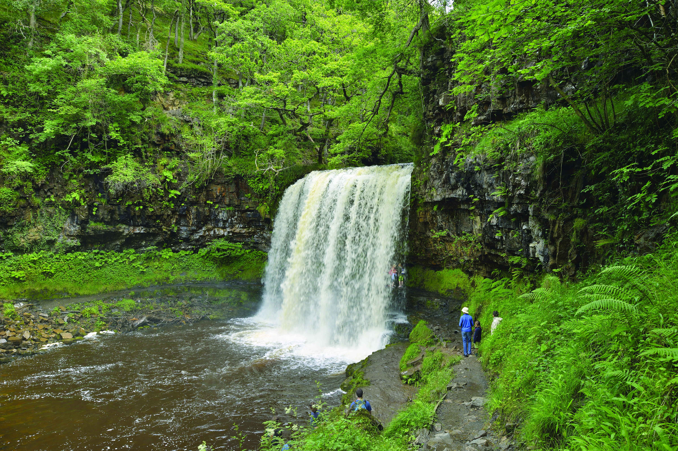
River landscapes
River processes: erosion
Hydraulic action is erosion by the power of moving water.
Abrasion is a type of erosion caused by the river’s load striking the bed and banks of the river.
Solution happens when the water slowly dissolves parts of the river channel.
Attrition happens when rock and stones carried by the river strike off each other.

Slide 7
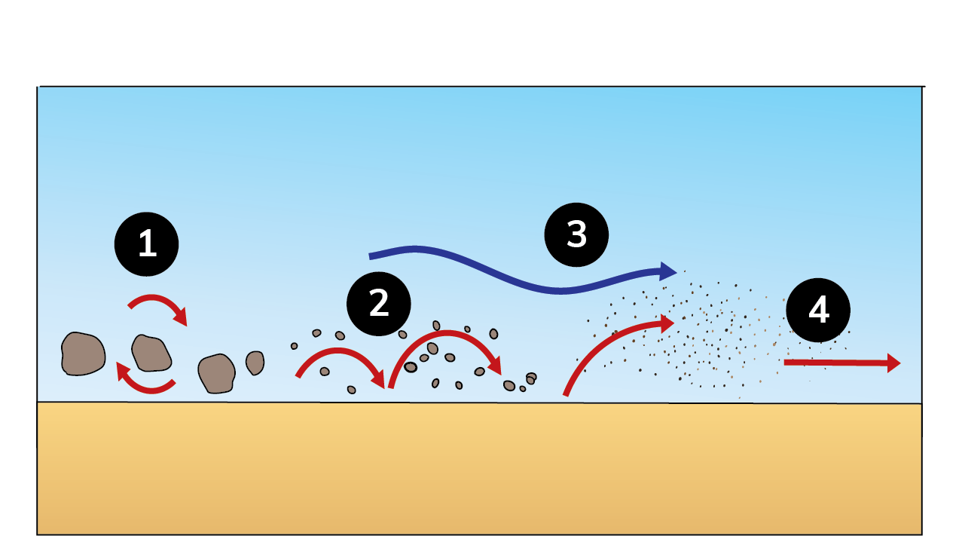
River landscapes
River processes: transportation
Rolling: Larger, heavier particles, such as pebbles and stones, are rolled along the riverbed by the force of the water.
Bouncing: Smaller particles, such as small pebbles and sand, are bounced along the riverbed.
Solution: Salts are dissolved in the water and are invisible.
Suspension: The lightest particles of silt and clay are carried along while suspended in the water.

Slide 8
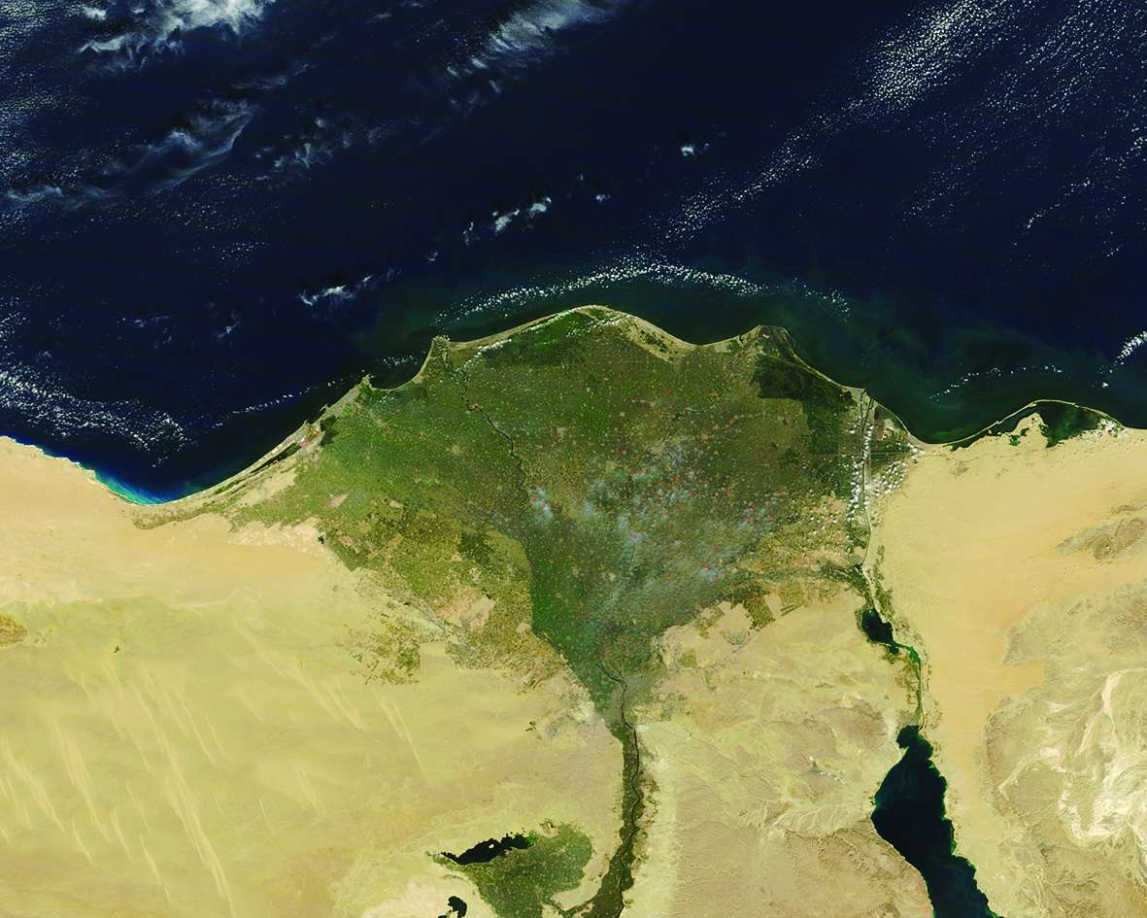
River landscapes
River processes: deposition
Decrease in speed: When a river slows down, there is less energy available to carry the bedload.
Decrease in volume: If the volume of water in the river decreases, bedload will be deposited.
Increase in bedload: If the sediment in a river increases, the river may not have enough energy to carry it.

Slide 9
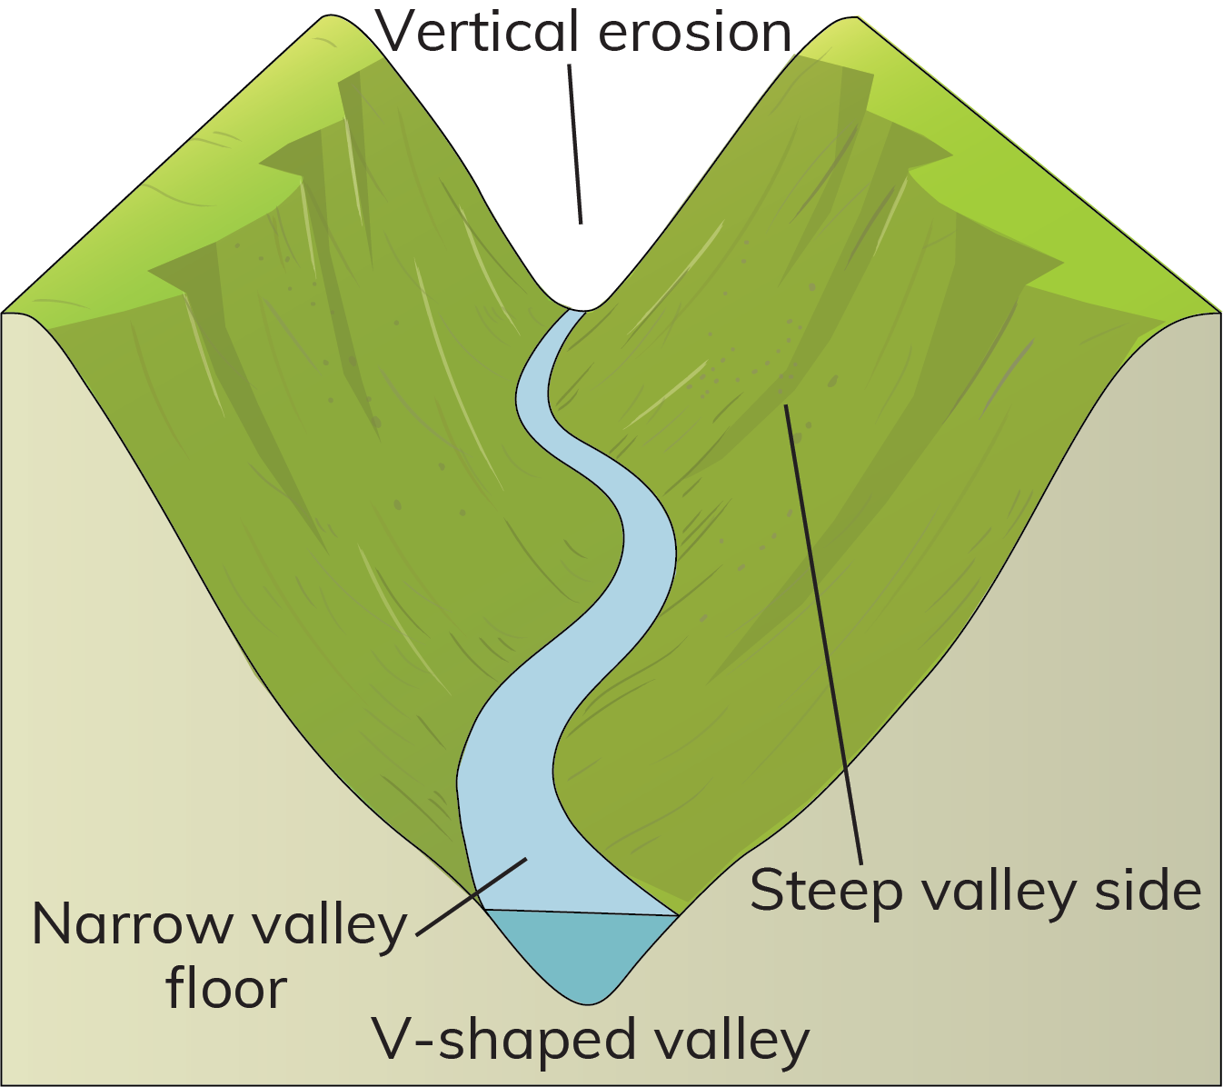
River landscapes
Landscape features of the upper course: V-shaped valley
A V-shaped valley forms in the upper course of a river. It has a narrow floor and steep sides. It is a feature of erosion.
It is formed by the process of vertical erosion when the river cuts down into its bed.
Soil and rock are weathered from the sides of the valley and mass movement carries weathered material to the river.
The processes of abrasion and hydraulic action deepen the river channel.
Over time, the valley becomes more V-shaped. An example is the upper course of the River Liffey in Co. Wicklow.

Slide 10
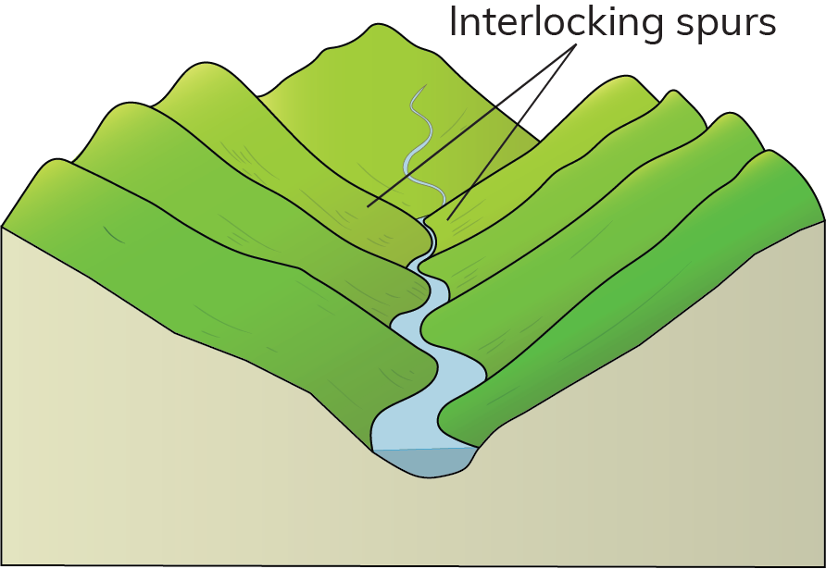
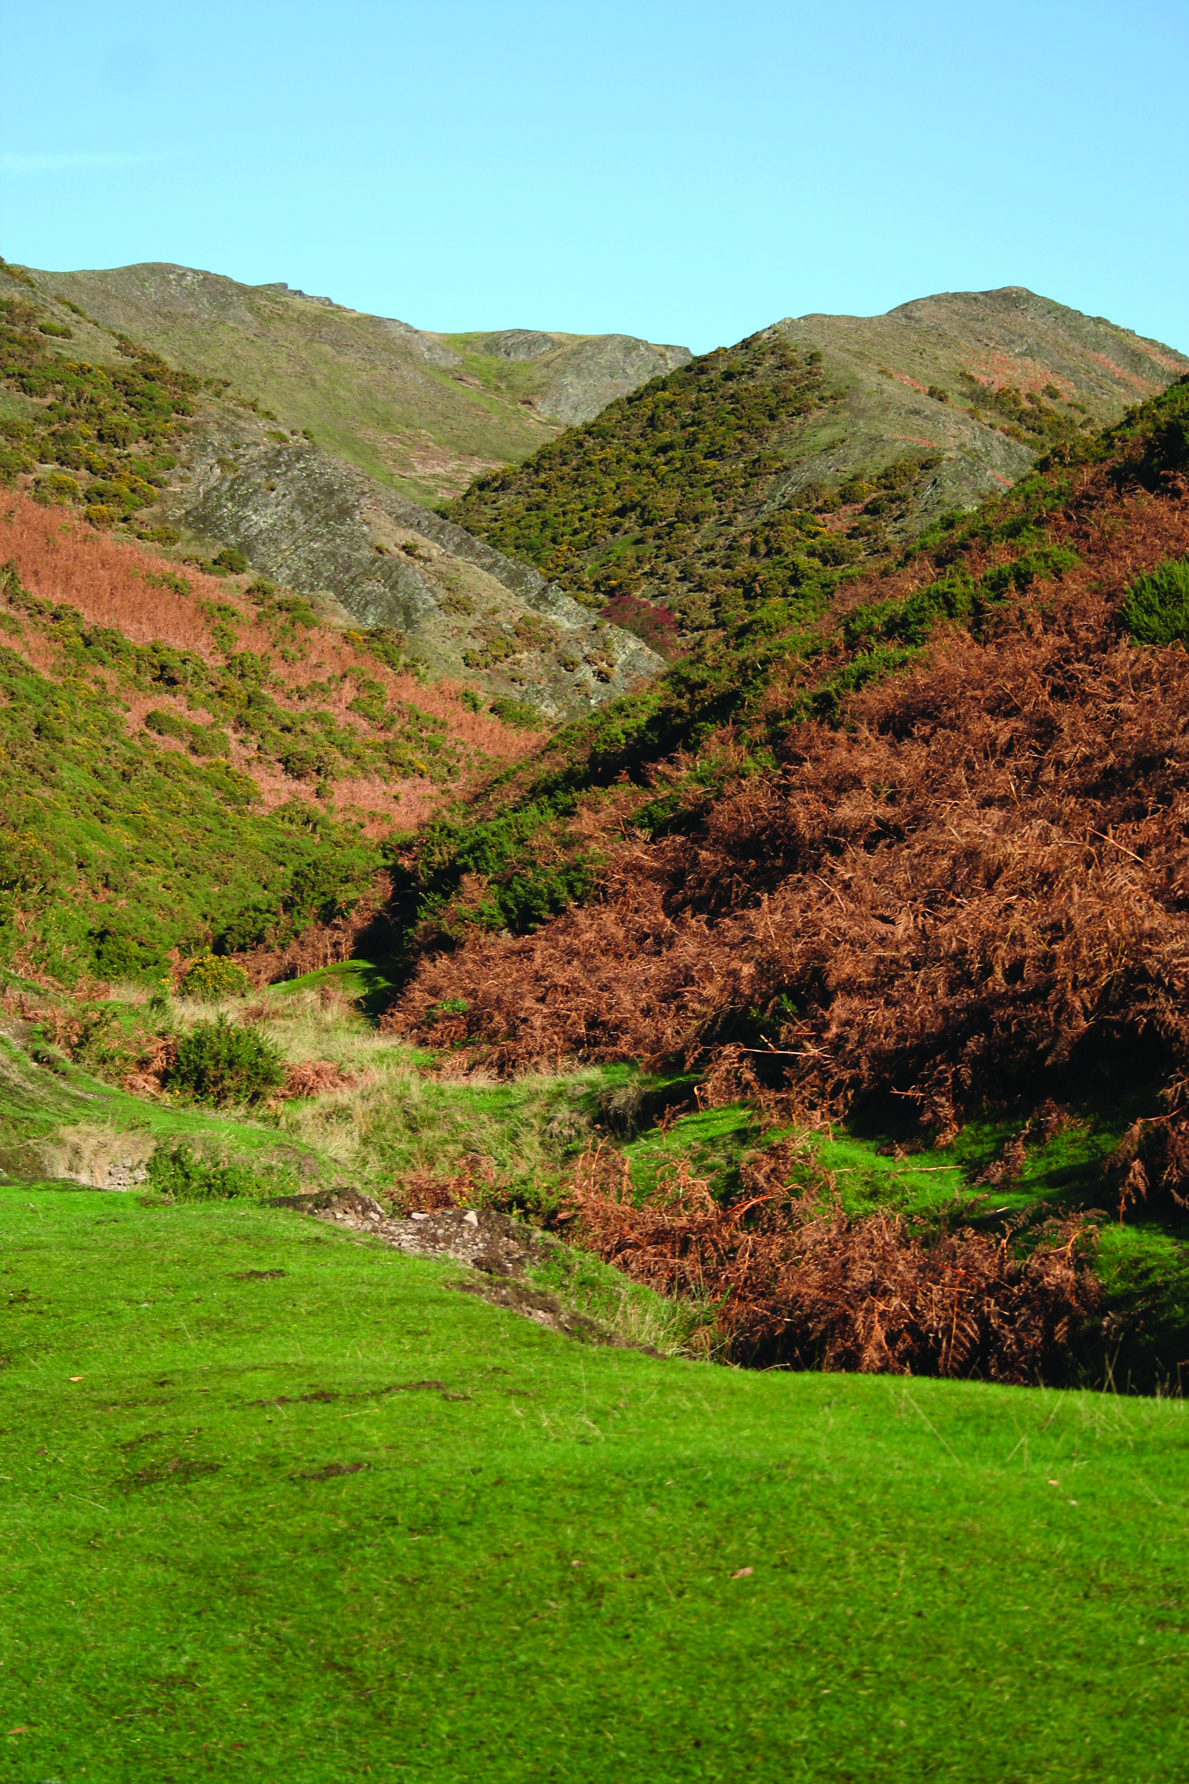
River landscapes
Landscape features of the upper course: interlocking spurs
Interlocking spurs are formed in the upper course.
They are areas of high ground that jut out on either side of the river and ‘interlock’ like parts of a zip.
Interlocking spurs are formed when a river meets sections of hard resistant rock. The river cannot erode through these sections so it flows around them.
The river continues to erode downwards (vertical erosion) using the processes of hydraulic action and abrasion. This leaves interlocking pieces of high ground sticking out – spurs – on either side of the river.
Examples are the upper course of the Rivers Liffey and Barrow.
Also, see OS map extract on page 68 of the textbook.

Slide 11
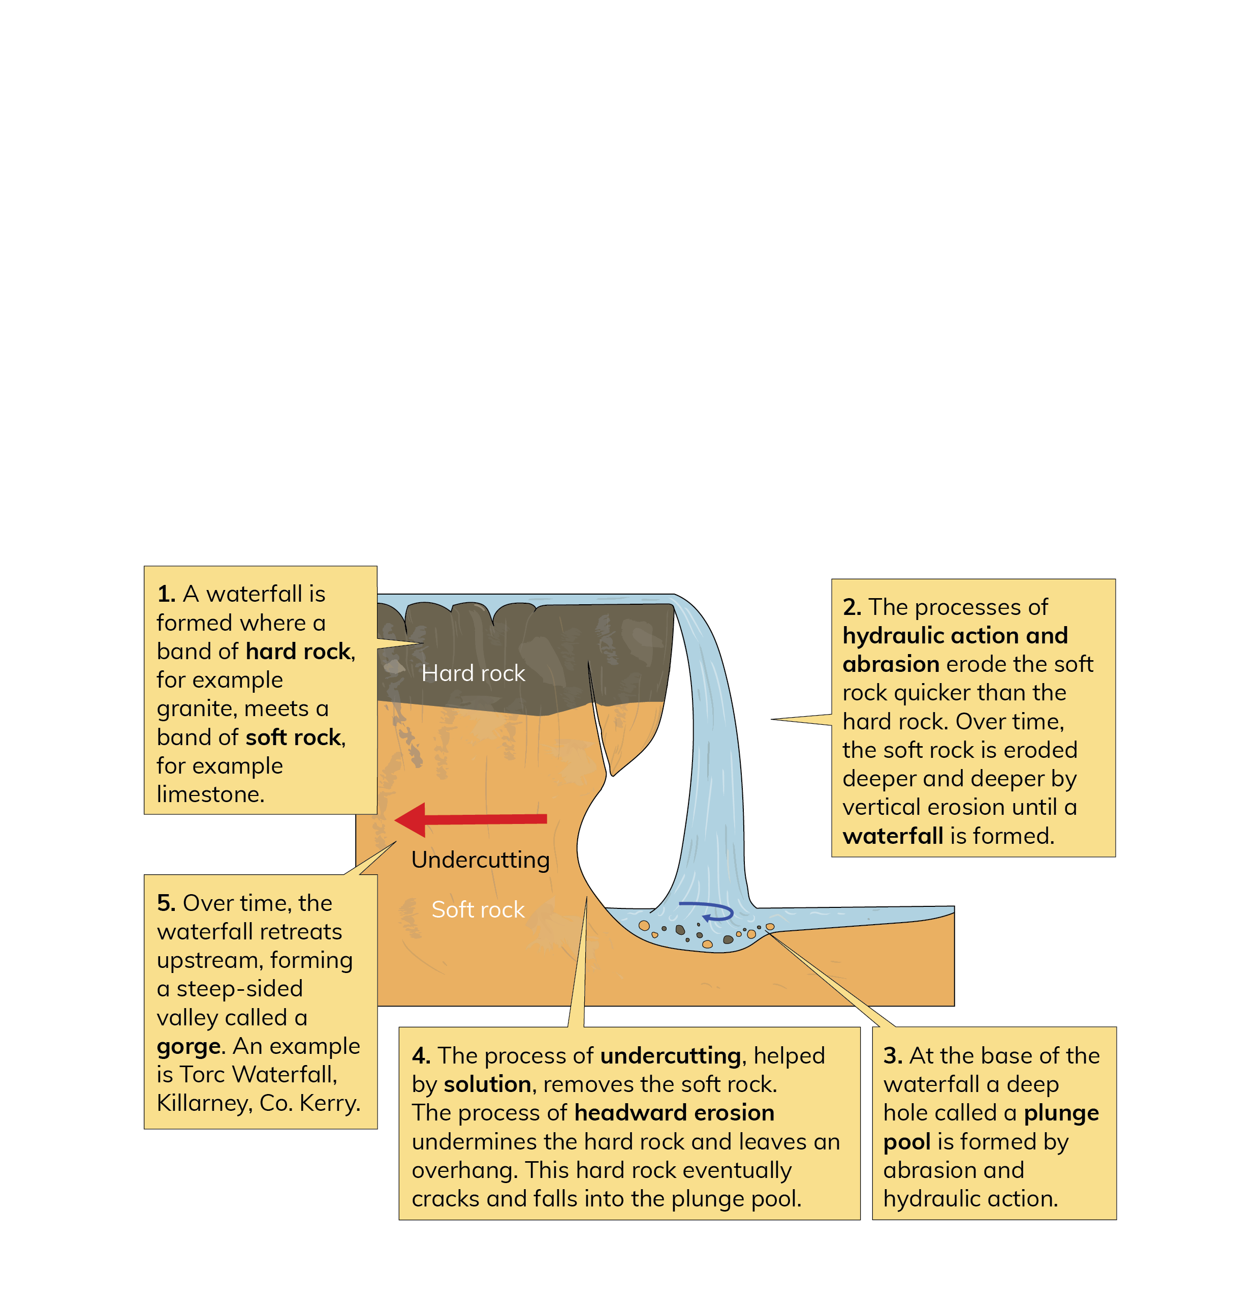
River landscapes
Landscape features of the upper course: waterfalls
Also, see OS map extract on page 69 of the textbook.

Slide 12
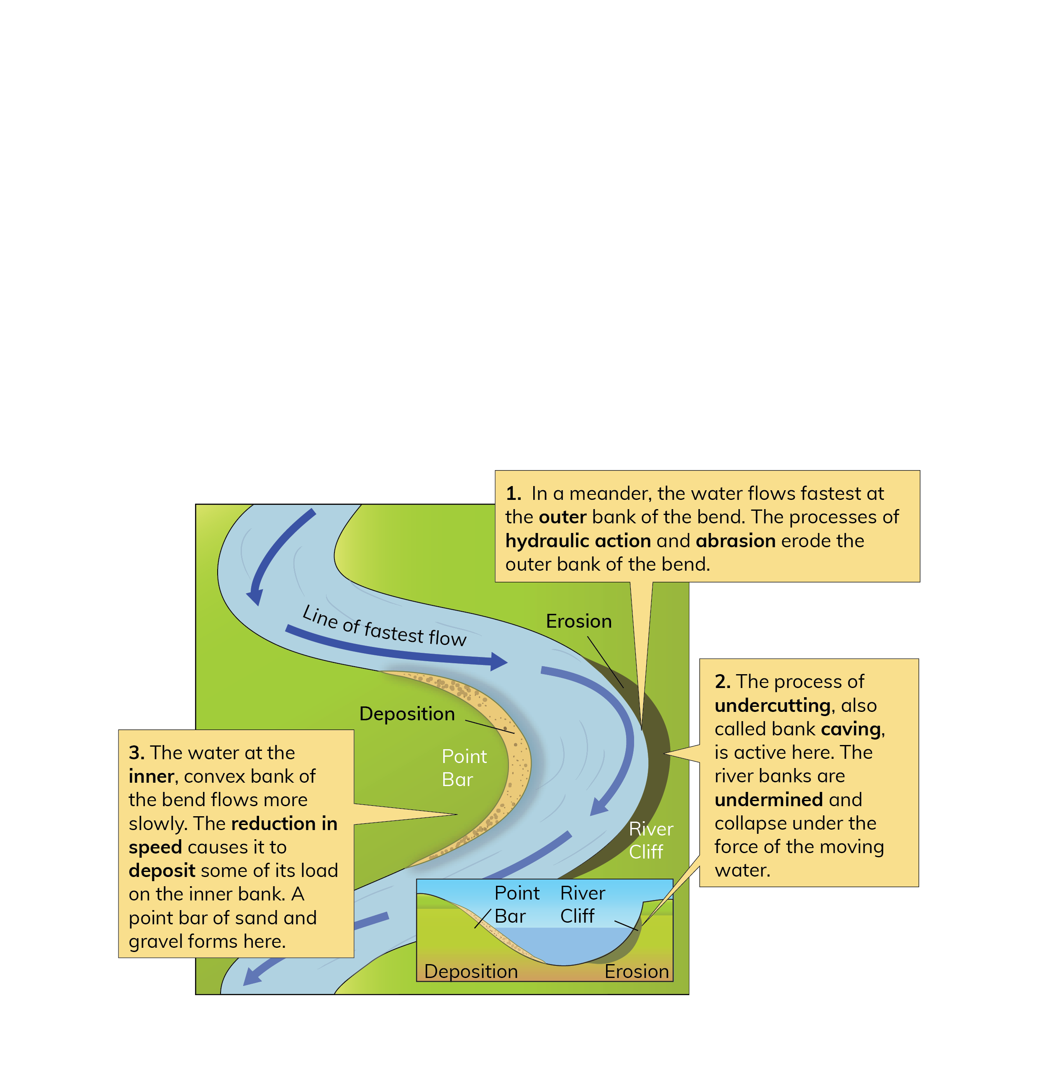
River landscapes
Landscape features of the middle course: meanders
Meanders are large bends or curves in the middle course of a river. They are features of erosion but are also formed by deposition.
Also, see OS map extract on page 70 of the textbook.

Slide 13
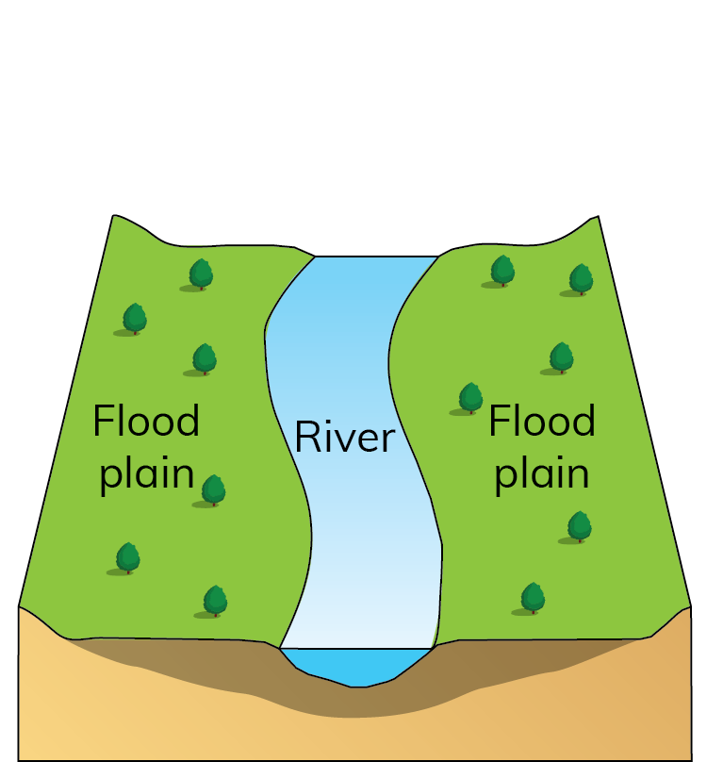
River landscapes
Landscape features of the middle course: floodplains
A floodplain is a wide area of flat land on either side of a river in its middle and lower course. It is a feature of deposition.
In the lower course, lateral erosion creates a wide area of flat land on either side of the river. During periods of heavy rain a river may flow over its banks, flooding the surrounding land.
When the river floods, it loses speed and deposits its load. Larger material is deposited nearest the riverbanks. Finer material – called alluvium – is deposited further away.
After repeated flooding, the alluvium builds up to form a level area on either side of the river called a floodplain. Examples are River Shannon east of Limerick and River Moy just north of Ballina, Co. Mayo.
Also, see OS map extract on page 71 of the textbook.

Slide 14
River landscapes
Landscape features of the lower course: oxbow lakes
An oxbow lake is a lake in the shape of a horseshoe on the floodplain of a river. It is a feature of deposition.
An oxbow lake forms when a meander becomes pronounced. Lateral erosion causes the neck of land between the ends of the meander to become very narrow.
Eventually, the river cuts across the narrow neck during a flood. This means that the river no longer follows the meander and flows straight along a new course.
The speed of the river decreases at the entrance to the old meander. This causes the deposition of alluvium, sealing off both ends of the meander. The loop is cut off and an oxbow lake forms.
Over time, an oxbow lake will dry up and become a meander scar or mort lake. Examples are River Moy north of Foxford, Co. Mayo, and Castletown River near Dundalk.

Slide 15
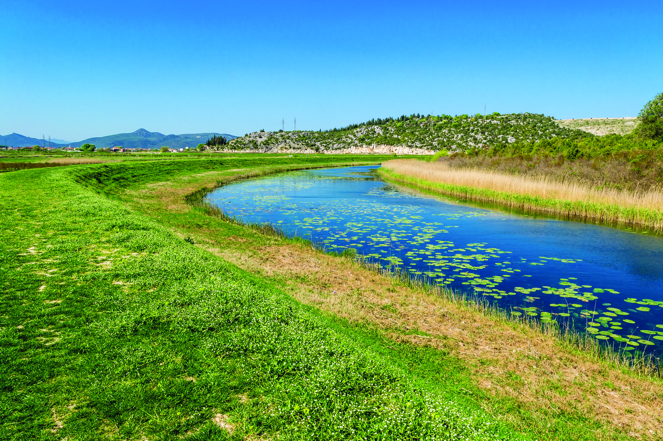
River landscapes
Landscape features of the lower course: levees
Levees are long, narrow ridges of alluvium located along the banks of a river in the lower course. They are features of deposition.
Also, see OS map extract on page 72 of the textbook.

Slide 16
River landscapes
Landscape features of the lower course: delta
A delta is a triangular area of land that forms in a river’s estuary. It is made of alluvium and is a feature of deposition.
When a river flows into a lake or the sea, it slows down and loses energy, depositing its sediment.
If the currents in the lake or sea are not able to carry all the sediment away, it will build up in the estuary. Over time a delta forms.
As the river flows through the delta, it breaks up into smaller channels, called distributaries. Examples include the Glenealo delta in the Upper Lake in Glendalough and the Nile delta in Egypt.
Also, see OS map extract on page 73 of the textbook.

Slide 17
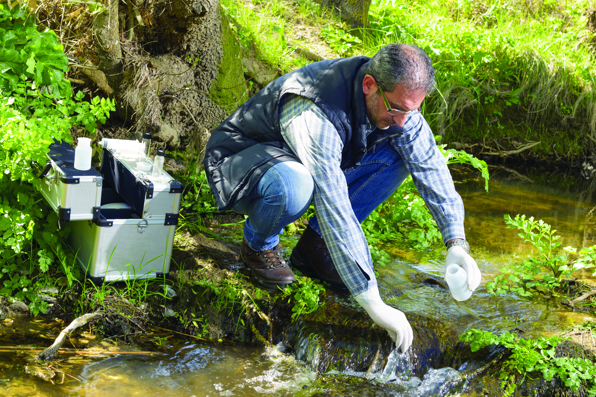
River landscapes
Work of a geographer: James Allen – a geomorphologist
A geomorphologist studies the surface processes that change the landscape.
Studied Geography in school and university
Specialised in rivers and river basin management
Tracks the behaviour of rivers over time
Collects volume and speed data on rivers and measures changes in the geography of river channels
Advises the ESB on how to manage river flow to their hydroelectric power stations and on the impact of sediment on their reservoirs
Advises county councils on planning permissions for developments near river floodplains

Slide 18
River landscapes
Review and reflect
Describe the process of abrasion and hydraulic action in a river.
Explain two reasons why rivers deposit their load.
Explain how one process of erosion leads to the formation of one river landform.
Choose one landform of river deposition. Explain how it formed.
At which feature along a river’s course should you be most careful? Why?

