Slide 1
Volcanoes
Chapter
2
Learning outcomes: 1.1, 2.1

Slide 2
At the end of this chapter, you will be able to:
2.1 Describe and explain how volcanoes are formed.
2.2 Name the different types of volcanoes.
2.3 Describe the distribution of volcanoes.
2.4 Describe and explain the economic and social impacts of volcanoes.
2.5 Describe and explain how people respond to and manage the effects of volcanoes.

Slide 3
Keyword connections

Slide 4
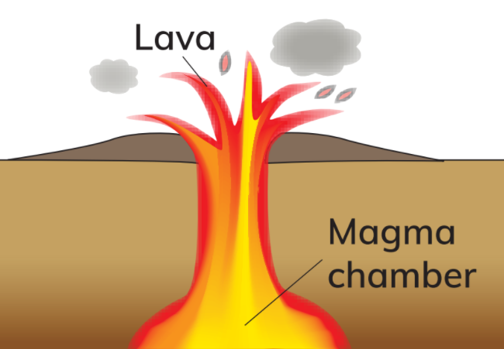
2.1 How Volcanoes are Formed
A volcanic mountain,
or volcano, forms
when magma moves
up to the surface of
the Earth through a
small opening called
a vent.

Slide 5
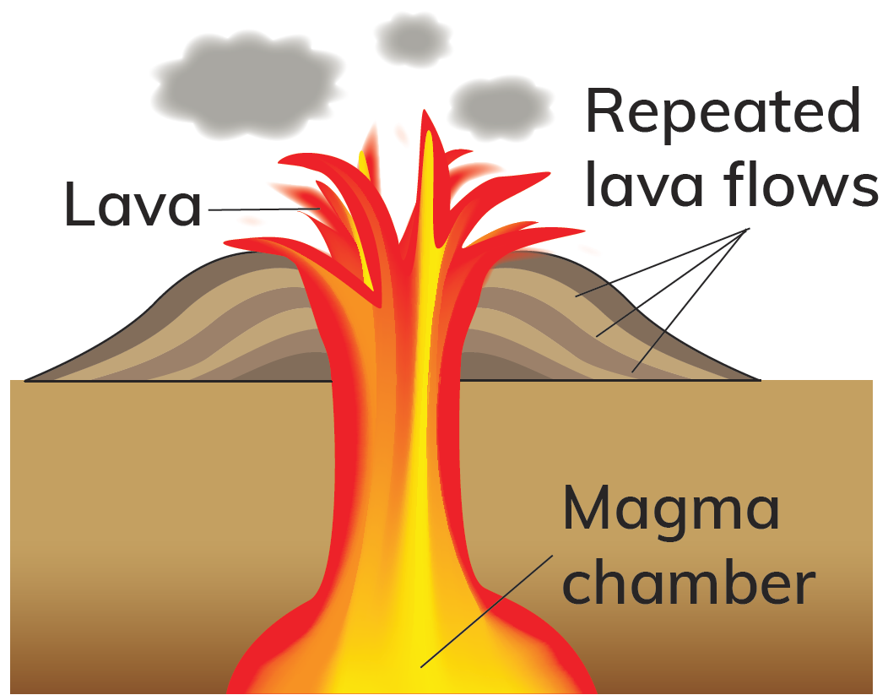
2.1 How Volcanoes are Formed
The magma is stored underground in
a magma chamber. The gases build up
in the magma chamber. The pressure
from the gases causes the magma
to erupt out of the vent through an
opening called a crater. When magma
reaches the Earth’s surface, it is known
as lava. The lava flow cools down and
hardens around the vent.

Slide 6
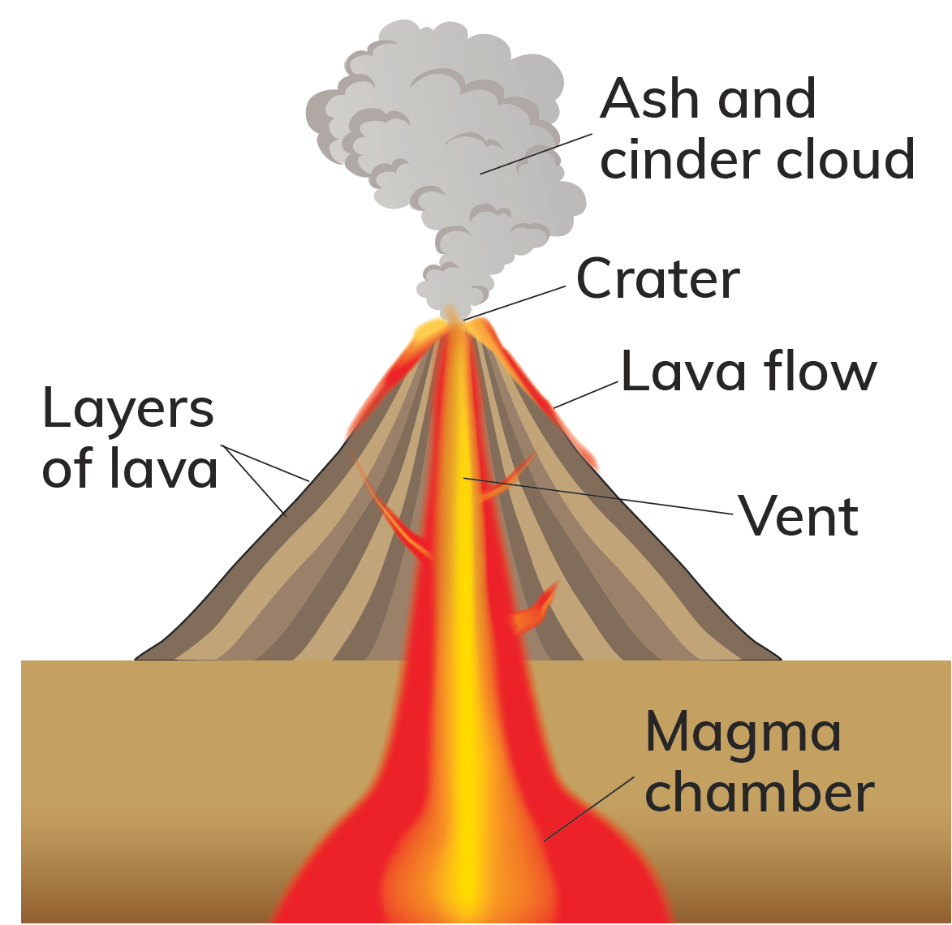
2.1 How Volcanoes are Formed
Other materials, such
as cinders and ash,
are also erupted
from a volcano. After
repeated eruptions,
layers of ash and
lava build up around
the vent to form
a cone-shaped
mountain.

Slide 7
2.1 How Volcanoes are Formed
Go to Section 2.1 on page 5 of your Skills Book.

Slide 8
2.2 The Life Cycle of a Volcano
Stage of life cycle | Description | Example
Stage 1: Active | Erupts regularly | Mount Etna, Italy
Stage 2: Dormant | Has not erupted for some time | Mount St Helens, USA; erupted in 1985 after 120 years
Stage 3: Extinct | Has not erupted in historic times | Slemish, Co. Antrim

Slide 9
2.1 & 2.2
1. What is a magma chamber?
2. What is the crater in a volcano?
3. What layers make up a volcanic mountain?
4. How did the Giant’s Causeway form?
5. What is meant by the term ‘active volcano’? Give an example.

Slide 10
2.1 & 2.2
Going further… 1
1. Where does the magma in a magma chamber come from?
2. What do you think happens to a magma chamber if it never erupts?
3. Do volcanoes always have to have violent eruptions?

Slide 11
2.2 The Life Cycle of a Volcano
Go to Section 2.2 on page 6 of your Skills Book.

Slide 12
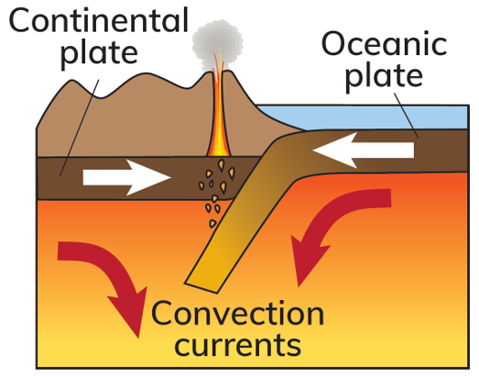
2.3 The Distribution of Volcanoes
Volcanoes can form at destructive plate boundaries, where two plates collide.
The heavier oceanic plate sinks below the lighter continental plate.
It melts in the mantle.
A blob of magma rises through the crust.
The magma can erupt and form a volcano.
Example: Mount St Helens, USA

Slide 13
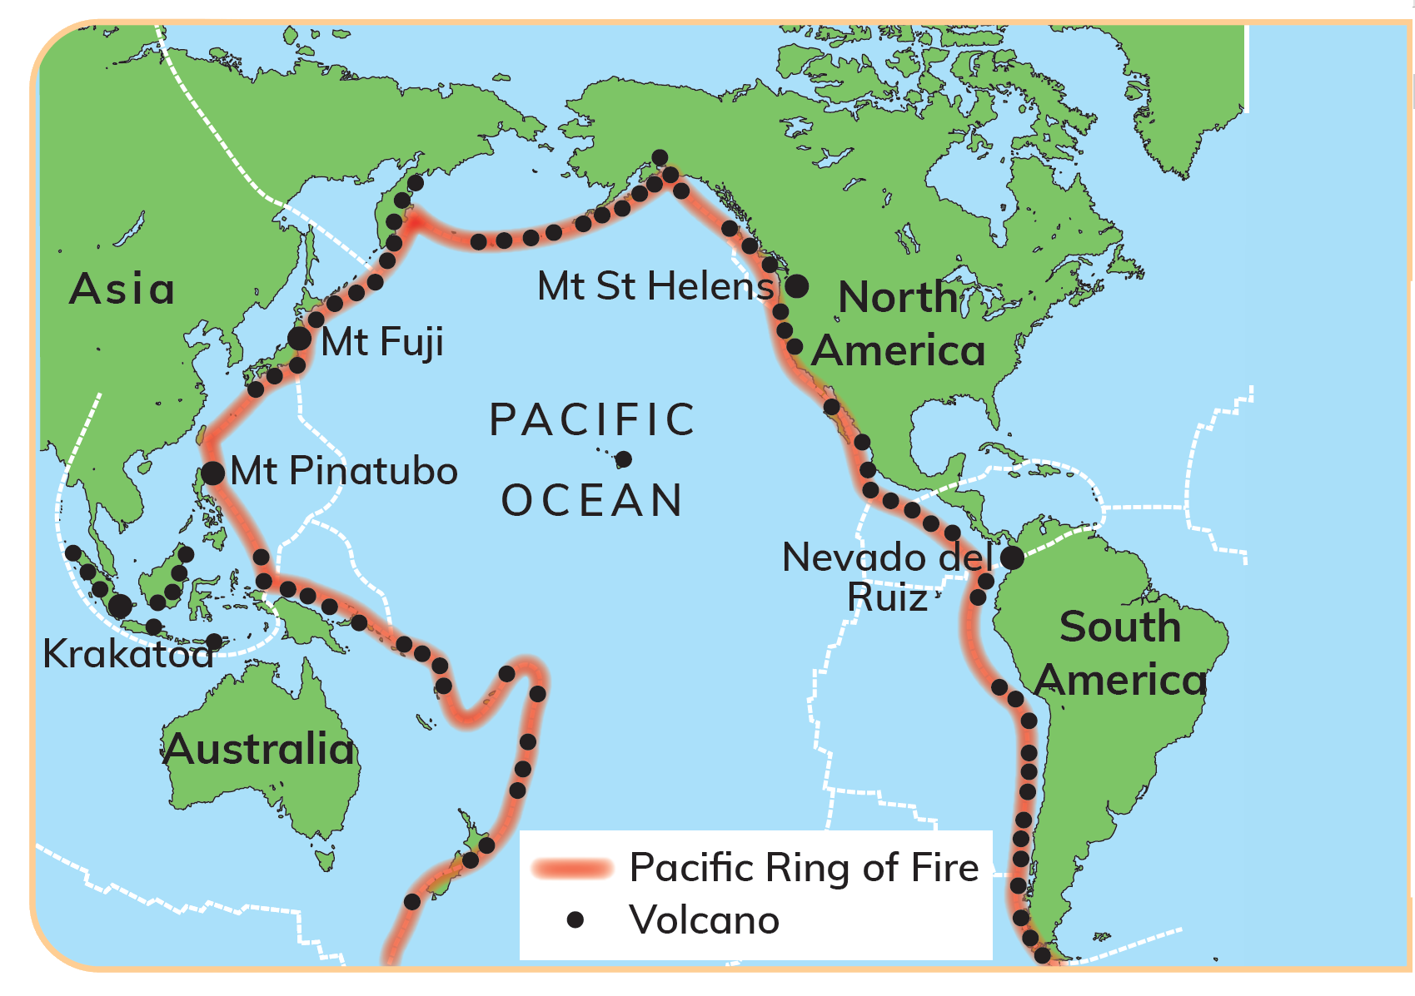
2.3 The Distribution of Volcanoes
The Pacific Ring of Fire

Slide 14
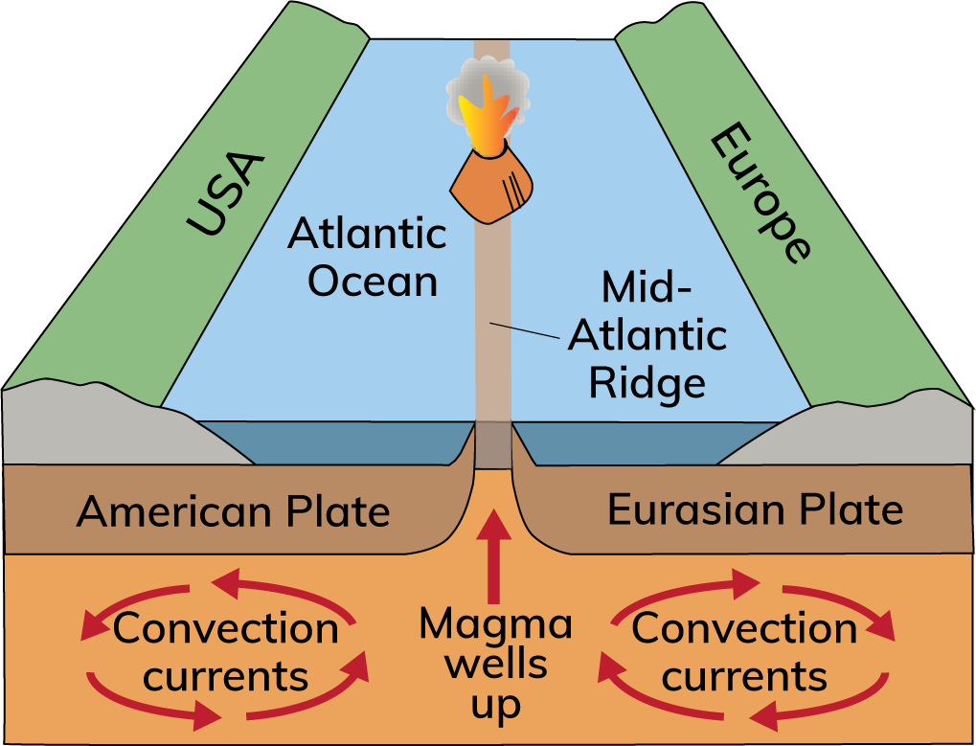
2.3 The Distribution of Volcanoes
Volcanoes can also form at constructive plate boundaries.
This happens when two plates separate.
Magma erupts and cools rapidly on the ocean floor.
Lava builds up.
A mid-ocean ridge forms.
Example: the Mid-Atlantic Ridge
If the mid-ocean ridge reaches the surface of the ocean, it forms a volcanic island.
Example: Iceland

Slide 15
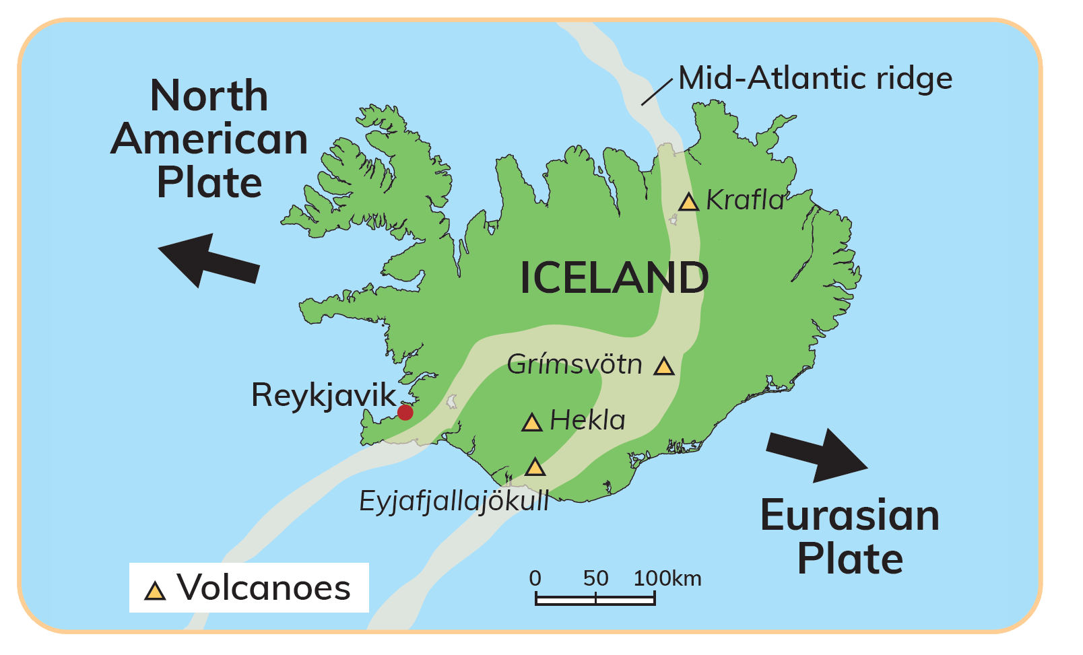
Iceland
Iceland is a volcanic island.
It sits on top of the Mid-Atlantic Ridge.
It formed when a volcanic mountain built up on the seabed.
Iceland contains about 130 volcanoes.
Examples: Hekla and Krafla
Iceland has many hot springs and geysers.

Slide 16
2.3 The Distribution of Volcanoes
Go to Section 2.3 on page 6 of your Skills Book.

Slide 17
2.3 The Distribution of Volcanoes
1. What does the word ‘distribution’ mean?
2. At what plate boundaries do volcanoes form?
3. Name one volcano that formed at a destructive plate boundary and one volcano that formed at a constructive plate boundary.
4. What is the Pacific Ring of Fire?
5. What is a volcanic island? Name one example.

Slide 18
2.3 The Distribution of Volcanoes
Going further… 2
1. What comes out of a volcano when it erupts? List as many things as you can think of. Where do all of these things go? (Hint: Do they all stay on the slopes of the volcano?)
2. Are there any constructive plate boundaries on land? Do they produce volcanoes?
3. What volcanic evidence is there that Ireland used to be on a plate boundary?

Slide 19
Keyword connections

Slide 20
2.4 The Economic and Social Impact of Volcanoes on Iceland
Positive economic impacts
1. Heating and electricity | 2. Agriculture and fish farming | 3. Tourism and recreation
Volcanoes produce geothermal energy. This is a renewable energy source. | Volcanic soil in Iceland is naturally warm. This helps grow potatoes and other vegetables. Geothermal energy is used to heat greenhouses. | Hot springs are a major tourist attraction. This earns valuable revenue. It provides jobs for local people in accommodation, transportation and retail.

Slide 21
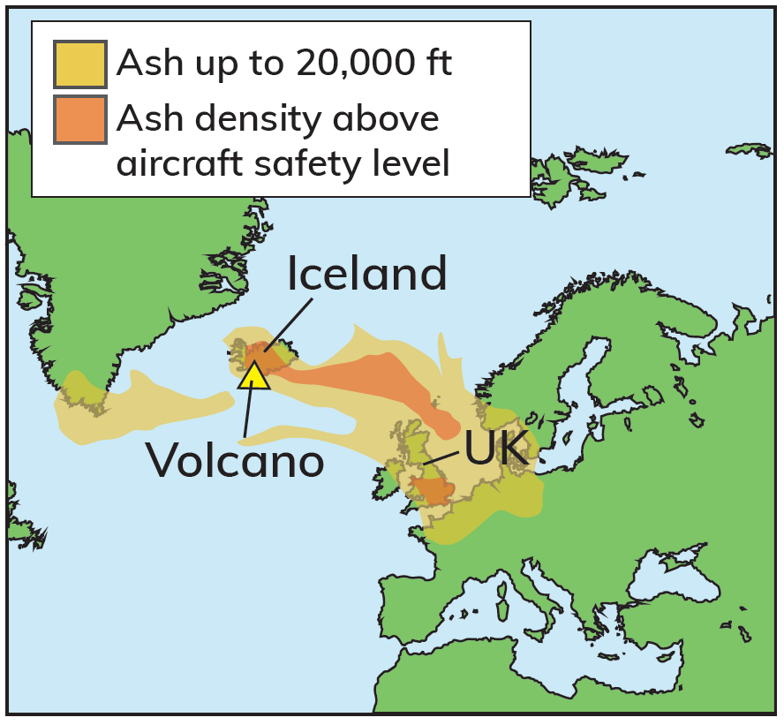
2.4 The Economic and Social Impact of Volcanoes on Iceland
Negative economic impacts
In March 2010, Eyjafjallajökull erupted:
A hot cloud of ash and volcanic glass was released into the atmosphere.
This caused severe disruption.
1. Travel
European air traffic control banned over 100,000 flights. 10 million people were affected. The ban on flying affected people travelling for business and tourism.
2. Transport
Fresh fruit, flowers, pharmaceuticals and electronic hardware could not be delivered. Companies in Africa and Asia were also affected. The overall cost of the ash cloud was approximately €3 billion.

Slide 22
2.4 The Economic and Social Impact of Volcanoes on Iceland
Positive social impacts
1. Improved health | 2. Job creation
Iceland’s capital, Reykjavik, is one of the cleanest cities in the world. Using geothermal energy has improved air quality and people’s health. It reduces Iceland’s impact on climate change. | Tourism helps to reduce outward migration. Young people have found jobs in hotels, bars and restaurants. Job creation helps maintain a stable population in Iceland.

Slide 23
2.4 The Economic and Social Impact of Volcanoes on Iceland
Negative social impacts
1. Settlement (1) | 2. Settlement (2)
The Mid-Atlantic Ridge runs through the middle of Iceland. As a result, large-scale settlement avoids the centre of the island. Most people live in or near the capital, Reykjavik, on the west coast. | The prevailing south-westerly wind carries the ash cloud from volcanoes towards the east. As a result, there are fewer settlements in the east of the country. To avoid this hazard from volcanic eruptions, seventy per cent of Iceland’s population lives in the south-west.

Slide 24
2.4 The Economic and Social Impact of Volcanoes on Iceland
1. What is geothermal energy?
2. Name three uses for geothermal energy in Iceland.
3. Describe briefly three positive impacts of volcanic activity in Iceland.
4. Describe three negative impacts of volcanic activity in Iceland.
5. Describe how geothermal energy has improved the wellbeing of people in Iceland.

Slide 25
2.4 The Economic and Social Impact of Volcanoes on Iceland
Going further… 3
1. Is there geothermal energy in Ireland?
2. How does geothermal energy help limit climate change?
3. Why do some people continue to live near volcanoes?

Slide 26
2.4 The Economic and Social Impact of Volcanoes on Iceland
Go to Section 2.4 on page 7 of your Skills Book.

Slide 27
2.5 Responding to Volcanoes
Pair Plan
Pair up with a classmate.
In March 2010, Eyjafjallajökull erupted.
Imagine that a volcano is about to erupt near where you live.
You have been given the job of managing the effects of the eruption.
What is your plan to get people to safety?
How will you deal with the aftermath of the eruption?

Slide 28
2.5 Responding to Volcanoes
Short-term responses | Long-term responses
Use search and rescue teams to find survivors. Survivors will need medical treatment. Provide food, water and shelter. Set up information points for relatives. Control the disaster area. | Preparation Disaster response systems to allow aid to be sent quickly to locations affected by disasters Planning Hazard mapping to predict the likely path of lava flows Education Training people to be prepared for a disaster Rebuilding Rebuilding damaged property Restoring services

Slide 29
2.5 Responding to Volcanoes
Go to Section 2.5 on page 7 of your Skills Book.

Slide 30
Assess your progress
Go to page 8 of your Skills Book and assess your progress.
2.1 Describe and explain how volcanoes are formed.
2.2 Name the different types of volcanoes.
2.3 Describe the distribution of volcanoes.
2.4 Describe and explain the economic and social impacts of volcanoes.
2.5 Describe and explain how people respond to and manage the effects of volcanoes.
Identify any gaps in your learning. Use the Rapid Revision on page 19 of your textbook to jog your memory.

