Slide 1
Positive Self-talk
WINNING WELLBEING

Slide 2
Positive Self-Talk
To build strong bodies, we must exercise and strengthen our muscles.
To build strong self-belief, we must exercise and strengthen our positive self-talk.

Slide 3
Self-Talk Is Our Inner Voice
Self-talk is the endless stream of unspoken thoughts that run through our heads. Every day, thousands of messages are sent to our brain. The majority of these are never spoken out loud, but our brain and body handle them internally. This inner voice is self-talk.
The average person can have 2,400 thoughts per hour or 57,600 thoughts per day. Researchers have found that 77% of everything we think is negative. That means 44,352 negative thoughts a day! This can be changed with positive self-talk.

Slide 4
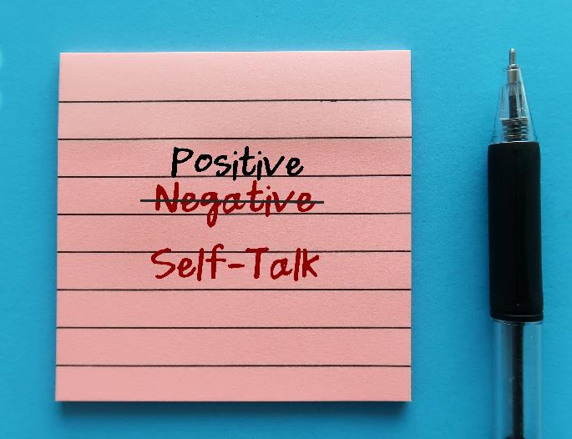
Self-Talk Affects Self-Esteem
Positive thinking often starts with self-talk. Our harshest critic is ourselves.
For example, if we play badly in a game, what do we say to ourselves?
‘You are so useless.’
If we are late handing in an assignment?
‘I’m useless – I’m never on time.’
If we get a bad result in a class test?
‘I’m so stupid.’
What kinds of things do you say to yourself?

Slide 5
The Brain Simply Believes What We Tell It Most!
What we tell our brain about ourselves, the brain will believe! Powerful and positive self-talk can change your entire mindset, which can affect your actions.
So, it is so important to stop telling ourselves negative messages and instead replace them with positive messages.

Slide 6
Picture a Stop Sign
Recognising negative self-talk is a step in the right direction.
Every time you catch yourself talking negatively to yourself, say loudly in your mind,
STOP!
and replace it with a positive statement.
‘I’m so slow at running.’ – ‘STOP!’
Replace it with: ‘I’m getting better and faster!’

Slide 7
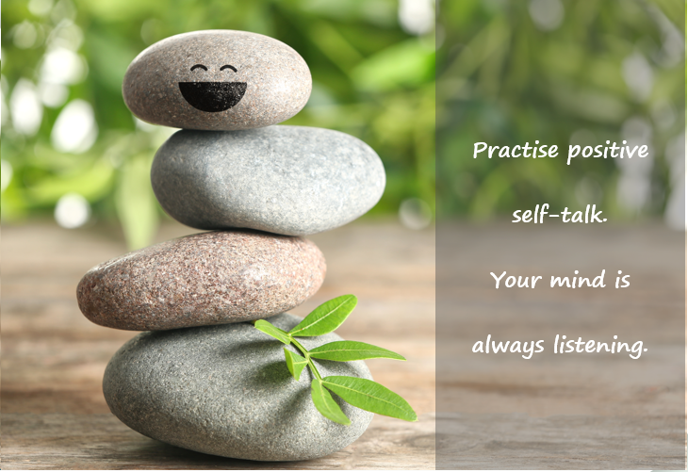
Many Athletes Find Success With Positive Self-Talk
In sports psychology, an athlete is taught to stay positive, calm, focused and confident, so they can see themselves as a winner, and to ‘picture the ball going in the net’.
Positive self-talk applies positive statements, such as ‘I can’ or ‘I will’. Take hurling, for example: ‘Could I make this point?’ OR ‘I can make this point.’
By stating the word ‘can’ instead of ‘could’, one is creating a sense of purpose, to score the point. Whereas using the word ‘could’ is the first step in casting doubt, which in turn may produce lower performance.

Slide 8
Stop Comparing Yourself to Others
Neuroscience considers self-talk as a kind of positive internal remodelling.
Do not compare yourself to others!
Comparison only fills your mind with negative thoughts and self-doubt.
Reaffirm how great you are doing through positive self-talk and remind yourself that your success has nothing to do with anyone else.

Slide 9
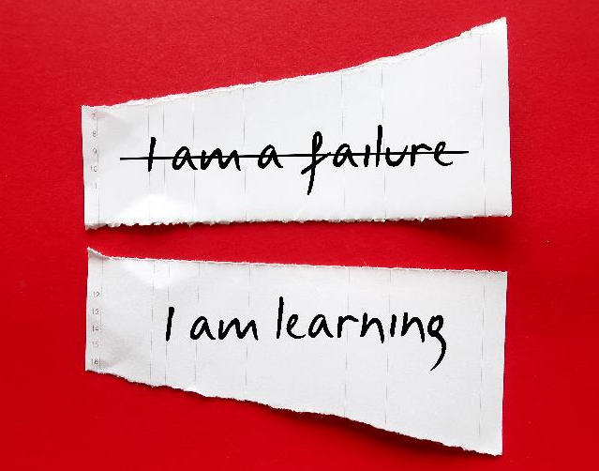
Time and Practice
Positive self-talk does not become a habit overnight. It is a skill that requires constant practice.
At first, you will notice yourself slipping up a bit, but learning to recognise when you are talking negatively to yourself is a huge first step.

Slide 10
Activity
Draw a line down the center of your page.
On the left-hand side, write down 10 negative statements you say to yourself throughout the day.
On the right-hand side, for each negative, write a positive statement.

